Slide 1
Twitter data extraction pipeline using AWS and Airflow

Slide 2
To perform Twitter data analysis using AWS SNS, Tweet, and Airflow Pandas, the following steps can be followed:
First, set up an AWS account and create an SNS topic to receive notifications from Twitter.
In the SNS topic settings, add the Twitter API credentials and specify the keywords or hashtags to track.
Use the Tweet API to fetch the relevant tweets and store them in a Pandas DataFrame for analysis.
Use Airflow to schedule the data fetching and analysis tasks and store the results in an S3 bucket.

Slide 3
Use Pandas to perform data analysis on the tweets, such as calculating the sentiment of the tweets, identifying the most popular hashtags, and analyzing the user engagement.
Generate a detailed report on the analysis using Pandas and store it in the S3 bucket for easy access.
Use AWS SNS to send notifications on the status of the analysis tasks and the availability of the report in the S3 bucket.
Overall, this approach allows for efficient and automated data analysis of Twitter data using the power of AWS and its various services.

Slide 4
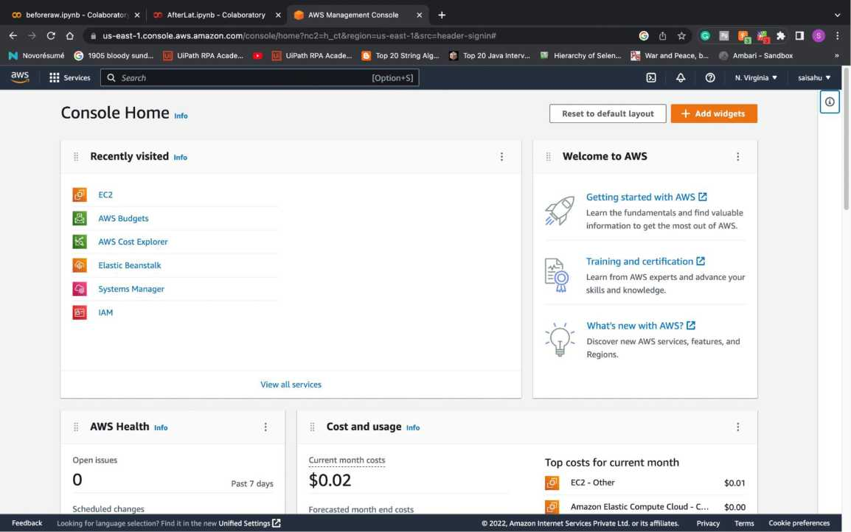
Login to AWS console

Slide 5
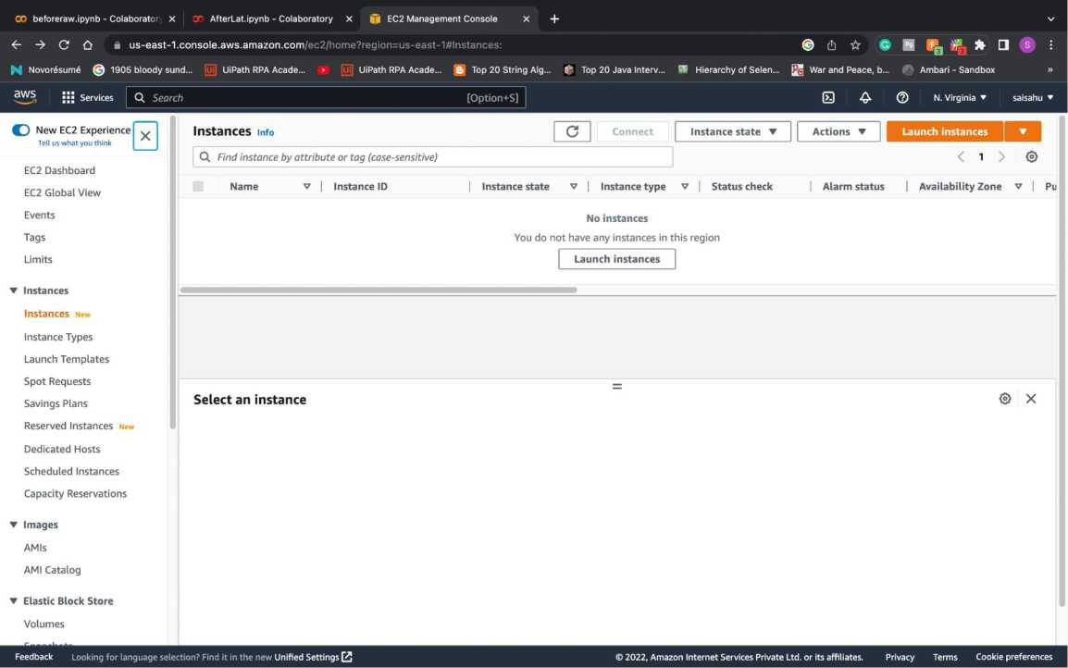
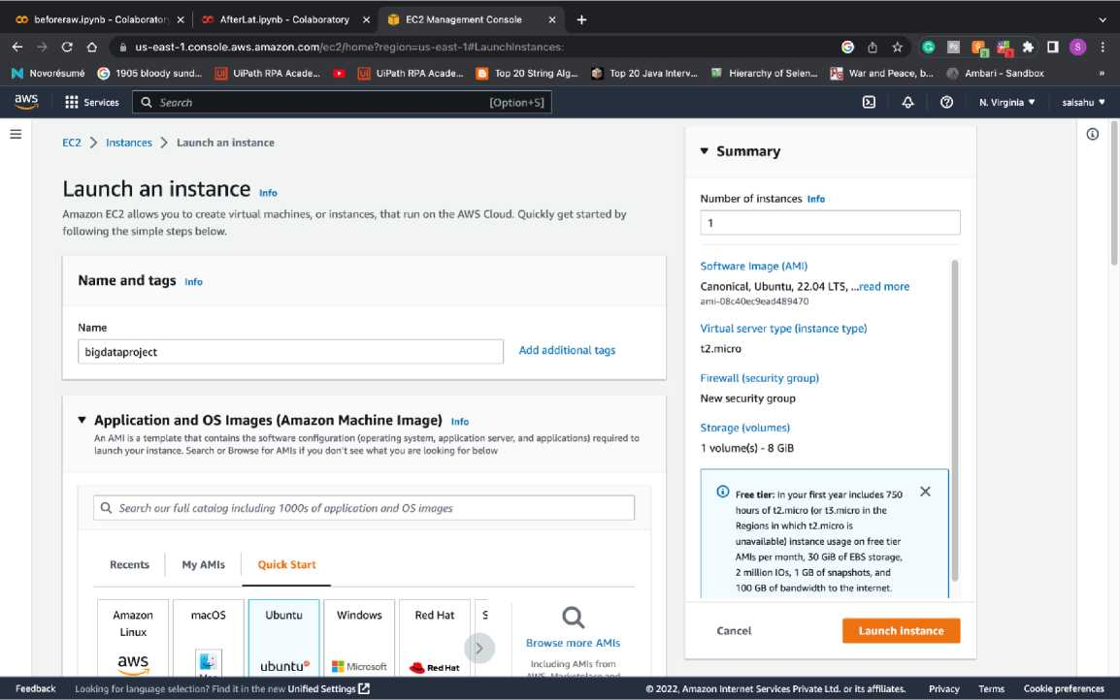
Navigate to EC2 Instance:
Lunch a instance with Ubuntu OS and T3.Medium

Slide 6
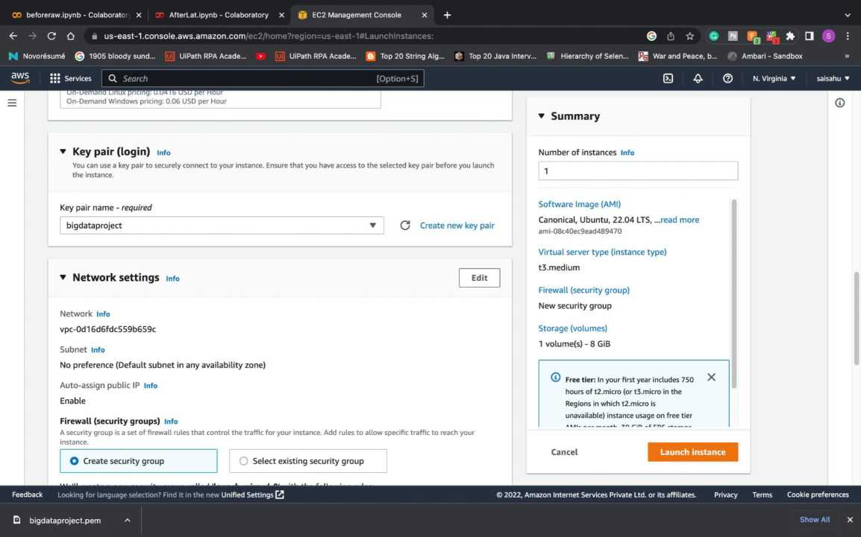

Slide 7
Instance is lunched with name as Bigdataproject
OO beforeraw.ipynb - Colaboratoi x I 30 AfterLat.ipynb - Colaboratory x |j| EC2 Management Console x i| Instances | EC2 Management x +
<- -> C £? ft us-east-1.console.aws.amazon.com/ec2/home?region=us-east-1#lnstances:instanceld=i-0764c3475b2aff001
^ Novor6sum6 @ 1905 bloody sund... [uj] UiPath RPA Acade... ► [Uj] UiPath RPA Acade... B Top 20 String Alg... ^ Top 20 Java Interv... SI Hierarchy of Selen... !s! Services Q, Search [Option+5]
(U ☆ # B @|, * □
! War and Peace, b... (F^ Ambari - Sandbox
0 A
N. Virginia ▼ saisahu ’
O New EC2 Experience ^
Tell us what you think
EC2 Dashboard
EC2 Global View
Events
Tags
Limits
▼ Instances
Instances New Instance Types Launch Templates Spot Requests Savings Plans Reserved Instances New Dedicated Hosts Scheduled Instances Capacity Reservations
Instances (1) info
Q. Find instance by attribute or tag (case-sensitive)
In stance ID =_ i:0764c3475b2aff 001 X
| Instance state v | Instance type v | Status check
©Running Q.Q, t3.medium ©Initializing
| Alarm status No alarms +
Name v | Instance ID
bigdataproject i-0764c3475b2aff00l
| Availability Zone V | Pu
us-east-la ec
Select an instance
▼ Images
AMIs
AMI Catalog
Feedback Looking for language selection? Find it in the new Unified Settings [£ | ©2022, Amazon Internet Services Private Ltd. or its affiliates. Privacy Terms Cookie preferences
Q bigdataproject.pem ^ | Show All X
SSH to the EC2 instance via terminal:
Last login: Sat Nov 26 21:03:22 on ttys003
[(base) saisahulPsais-MacBook-Air - % cd download ]
cd: no such file or directory: dowmload
[(base) saisahu@sais-MacBook-Air * X cd download ]
cd: no such file or directory: download
[(base) saisahu@sais-MacBook-Air ~ % cd downloads ]
[(base) saisahuQsais-MacBook-Air downloads % ssh -i "bigdataproject.pern" ubuntu@ec2-44-204-123-51.compute-l.amazonaws.com ]
@ WARNING: UNPROTECTED PRIVATE KEY FILE! G>
Permissions 0644 for 'bigdataproject.pern' are too open.
It is required that your private key files are NOT accessible by others.
This private key will be ignored.
Load key "bigdataproject.pem": bad permissions
[(base) saisahu@sais-MacBook-Air downloads % ssh -i "bigdataproject.pern" ubuntu@ec2-44-204-123-51.compute-l.amazonaws.com ]
Welcome to Ubuntu 22.04.1 LTS (GNU/Linux 5.15.0-1019-aws x86_64)
* Documentation: https://help.ubuntu.com
* Management: https://landscape.canonical.com
* Support: https://ubuntu.com/advantage
System information as of Sun Nov 27 02:04:44 UTC 2022
System load: 0.2060546875 Processes: 111
Usage of /: 19.6% of 7.57GB Users logged in: 0
Memory usage: 5% IPv4 address for ens5: 172.31.13.219
Swap usage: 0K
0 updates can be applied immediately.
The list of available updates is more than a week old. To check for new updates run: sudo apt update
The programs included with the Ubuntu system are free software; the exact distribution terms for each program are described in the individual files in /usr/share/doc/*/copyright.
Ubuntu comes with ABSOLUTELY NO WARRANTY, to the extent permitted by applicable law.
To run a command as administrator (user "root”), use "sudo <command>". See "man sudo_root" for details.
ubuntu@ip-172-31-13-219:-$ |

Slide 8
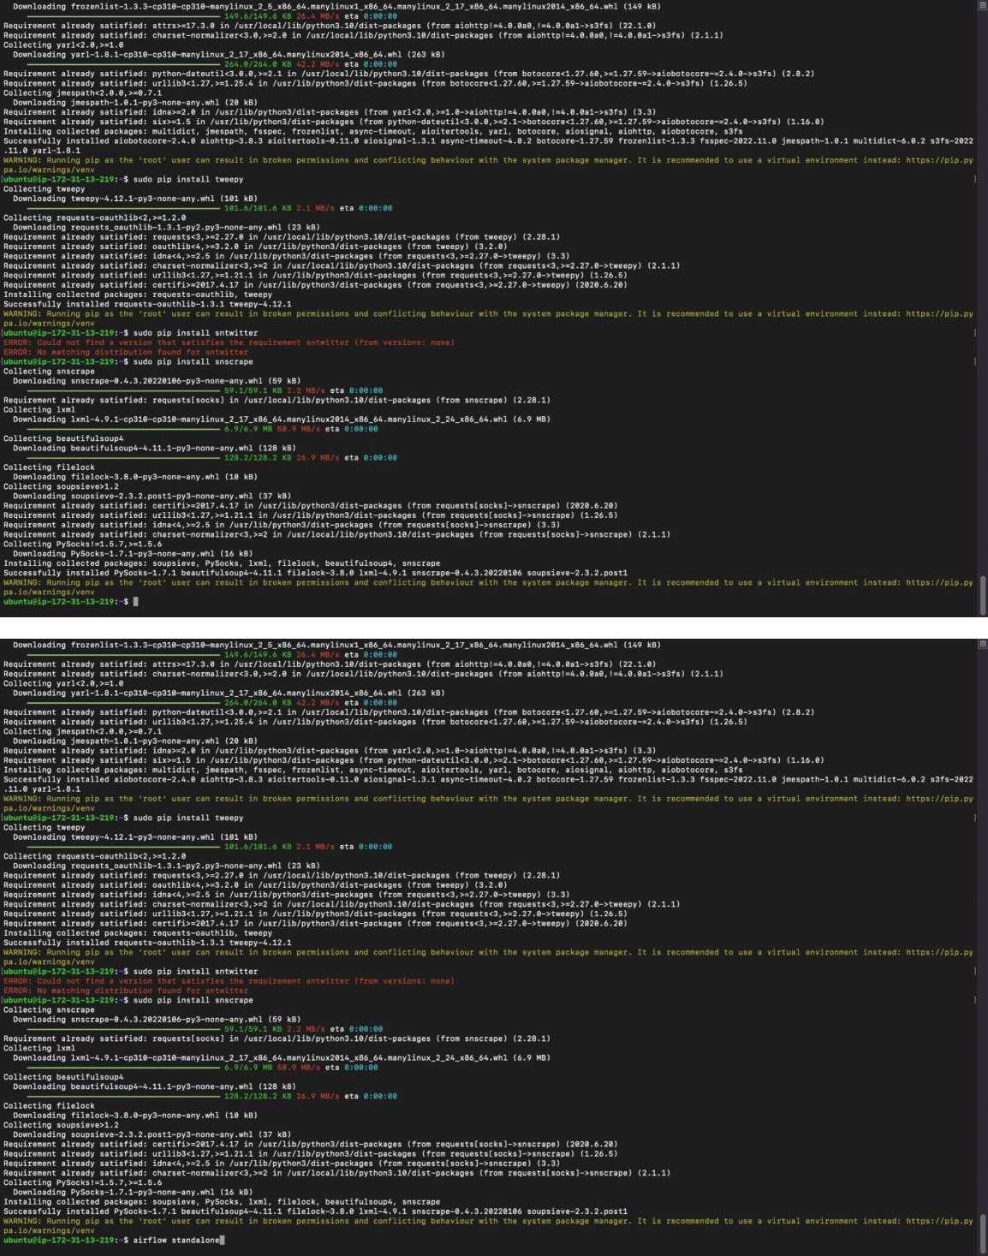
On the instance, Install Python, pandas, Airflow, SNStwitter

Slide 9
685] {manager.py: 691] {manager.py: ,696] {manager.py: ,703] {manager.py: ,710] {manager.py: ,716] {manager.py: 724] {manager.py; ,731] {manager.py: 733] {manager.py: ,745] {manager.py: 751] {manager.py: ,758] {manager.py: ,764] {manager.py: 772] {manager.py: ,779] {manager.py: 788] {manager.py: ,795] {manager.py: ,801] {manager.py: ,807] {manager.py: ,814] {manager.py: ,821] {manager.py: ,830] {manager.py: ,837] {manager.py: ,844] {manager.py: ig admin user ,052] {manager.py:! I admin user
Permission can create on Connections to role Op Permission can read on Connections to role Op Permission can edit on Connections to role Op Permission can delete on Connections to role Op Permission can create on Pools to role Op Permission can read on Pools to role Op
Permission can edit on Pools to role Op
Permission can delete on Pools to role Op Permission can read on Providers to role Op Permission can create on Variables to role Op Permission can read on Variables to role Op
Permission can edit on Variables to role Op
Permission can delete on Variables to role Op Permission can delete on XComs to role Op Permission can read on DAOs to role Admin Permission can read on DAG Dependencies to role Admin Permission can read on DAG Code to role Admin Permission can read on Datasets to role Admin Permission can read on ImportError to role Admin Permission can read on DAG Warnings to role Admin Permission can read on Task Logs to role Admin Permission can read on Website to role Admin Permission can edit on DAGs to role Admin Permission can delete on DAGs to role Admin
____ !\ |_ /...../_ /___/___\_ | /| / /
___ ___ | / _ / _ _ ///_//_ |/ 1/ /
_/_/ I _/_/ u /_/ /_/ \____i____/1__/
[2022-11-27 02:10:56,388] {triggerer.job.py:101} INFO - Starting the triggerer
____ |__( ).........../________ __
____ /| |_ /__ ___/_ /___/___\_ | /| / /
___ ___ | / _ / _ _ ///_//_ |/ |/ /
_/_/ I _/_/ /_/ /_/ /_/ \____/____/1__/
[2022-11-27 02:10:56 +0000] [3119] [INFO] Starting gunicorn 20.1.0 [2022-11-27 02:10:56 +0000] [3119] [INFO] Listening at: http://[::]:8793 (3119)
[2022-11-27 02:10:56 +0000] [3119] [INFO] Using worker: sync [2022-11-27 02:10:56 +0000] [3120] [INFO] Booting worker with pid: 3120 [2022-11-27 02:10:56,686] {scheduler.]ob.py:700} INFO - Starting the scheduler [2022-11-27 02:10:56,693] {scheduler.]'ob.py:705} INFO - Processing each file at most -1 times [2022-11-27 02:10:56,696] {executor.loader.py:107} INFO- Loaded executor: SequentialExecutor [2022-11-27 02:10:56,703] {manager.py:163} INFO - Launched DagFileProcessorManager with pid: 3121 [2022-11-27 02:10:56,705] {scheduler.job.py:1380> INFO - Resetting orphaned tasks for active dag runs [2022-11-27 02:10:56,718] {settings.py:58} INFO - Configured default timezone Timezone!'UTC')
[2022-ll-27T02:10:56.747+0000] {manager.py:409} WARNING - Because we cannot use more than 1 thread (parsing.processes = 2)
[2022-11-27 02:10:56 +0000] [3122] [INFO] Booting worker with pid: 3122
[2022-11-27 02:11:00 +0000] [3118] [INFO] Starting gunicorn 20.1.0
[2022-11-27 02:11:00 +0000] [3118] [INFO] Listening at: http://9.0.9.0:8080 (3118)
[2022-11-27 02:11:00 +0000] [3118] [INFO] Using worker: sync [2022-11-27 02:11:00 +0000] [3127] [INFO] Booting worker with pid: 3127
[2022-11-27 02:11:00 +0000] [3128] [INFO] Booting worker with pid: 3128
[2022-11-27 02:11:00 +0000] [3129] [INFO] Booting worker with pid: 3129
[2022-11-27 02:11:00 +0000] [3130] [INFO] Booting worker with pid: 3130
Airflow is ready
Login with username: admin password: dkqWhkVQKtnXygGg
Airflow Standalone is for development purposes only. Do not use this in production!
i using sqlite. So we set parallelism to 1.
,685] {man;
691] {man.
,696] {man;
703] {man;
,710] {man;
716] {man;
724] {man;
731] {man;
] {
] {
] {
758] {man;
] {
] {
779] {man;
788] {man;
,795] {man;
801] {man;
807] {man;
814] {man;
821] {man;
830] {man;
837] {manager.py ] {
ig admin user
052] {manager.py I admin user
567} INFO -567} INFO -567} INFO -567} INFO -567} INFO -567} INFO -567} INFO -567} INFO -567} INFO -567} INFO -567} INFO -567} INFO -567} INFO -567} INFO -567} INFO -567} INFO -567} INFO -567} INFO -567} INFO -567} INFO -567} INFO -567} INFO ■ 567} INFO -567} INFO -
- Added Permission can
- Added Permission can
- Added Permission can
- Added Permission can
- Added Permission can
- Added Permission can
- Added Permission can
- Added Permission can
- Added Permission can
- Added Permission can
- Added Permission can
- Added Permission can
- Added Permission can
- Added Permission can
- Added Permission can
- Added Permission can
- Added Permission can
- Added Permission can
- Added Permission can
- Added Permission can
- Added Permission can
- Added Permission can
- Added Permission can
- Added Permission can
i - Added user admin
create on Connections to role Op
read on Connections to role Op
edit on Connections to role Op
delete on Connections to role Op
create on Pools to role Op
read on Pools to role Op
edit on Pools to role Op
delete on Pools to role Op
read on Providers to role Op
create on Variables to role Op
read on Variables to role Op
edit on Variables to role Op
delete on Variables to role Op
delete on XComs to role Op
read on DAGs to role Admin
read on DAG Dependencies to role Admin
read on DAG Code to role Admin
read on Datasets to role Admin
read on ImportError to role Admin
read on DAG Warnings to role Admin
read on Task Logs to role Admin
read on Website to role Admin
edit on DAGs to role Admin
delete on DAGs to role Admin
___ |__( )_______ /______ __
___/| |_ /__ ___/_ /__/___\_ | /1 / /
__ __ | / _ / _ __/ _ ///_//_ |/ |/ /
_/_/ I _/_/ /_/ /_/ /_/ \____/____/1__/
[ ] { 101} INFO - Starting the triggerer
HU TII< )_____ZIZ""H/H~~/________ __
___/| |_ /__ ___/_ /___/___\_ | /1 / /
__ __ | / _ / . _ ///_//_ |/ |/ /
_/_/ I _/_/ /_/ /_/ /_/ \___/___/1_/
[2022-11-27 02:10:56 +0000] [3119] [INFO] Starting gunicorn 20.1.0 [2022-11-27 02:10:56 +0000] [3119] [INFO] Listening at: http://[::]:8793 (3119)
[2022-11-27 02:10:56 +0000] [3119] [INFO] Using worker: sync
[2022-11-27 02:10:56 +0000] [3120] [INFO] Booting worker with pid: 3120 [ ] { 700} INFO - Starting the scheduler
[ ] { 705} INFO - Processing each file at most -1 times
[ ] { 107} INFO - Loaded executor: SequentialExecutor
[ ] { 163} INFO - Launched DagFileProcessorManager with pid: 3121
[ ] { 1380} INFO - Resetting orphaned tasks for active dag runs
[ ] { 58} INFO - Configured default timezone Timezone('UTC')
[2022-11-27T02:10:56.747+0000] {manager.py:409} WARNING - Because we cannot use more than 1 thread (parsing.processes = 2) when using sqlite. So we set parallelism to 1.
[2022-11-27 02:10:56 +0000] [3122] [INFO] Booting worker with pid: 3122
[2022-11-27 02:11:00 +0000] [3118] [INFO] Starting gunicorn 20.1.0
[2022-11-27 02:11:00 +0000] [3118] [INFO] Listening at: http://0.0.0.0:8080 (3118)
[2022-11-27 02:11:00 +0000] [3118] [INFO] Using worker: sync
[2022-11-27 02:11:00 +0000] [3127] [INFO] Booting worker with pid: 3127
[2022-11-27 02:11:00 +0000] [3128] [INFO] Booting worker with pid: 3128
[2022-11-27 02:11:00 +0000] [3129] [INFO] Booting worker with pid: 3129
[2022-11-27 02:11:00 +0000] [3130] [INFO] Booting worker with pid: 3130
Airflow is ready
Login with username: admin password: dkqWhkVQKtnXygGg
Airflow Standalone is for development purposes only. Do not use this in production!

Slide 10
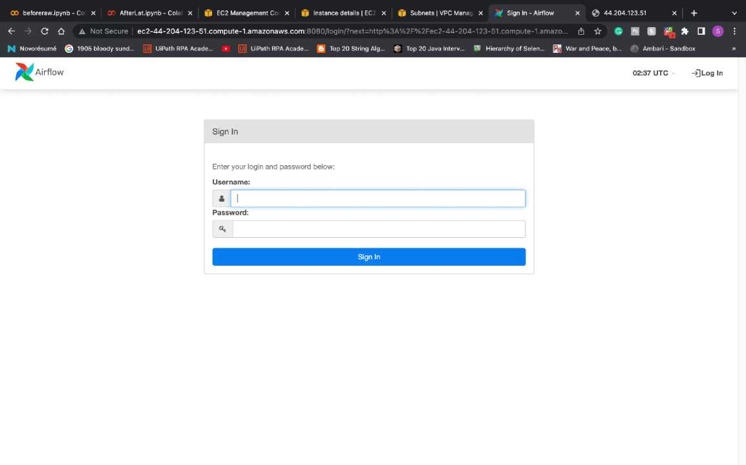
Once airflow is installed run command to open it and use passowrd/username from terminal:

Slide 11
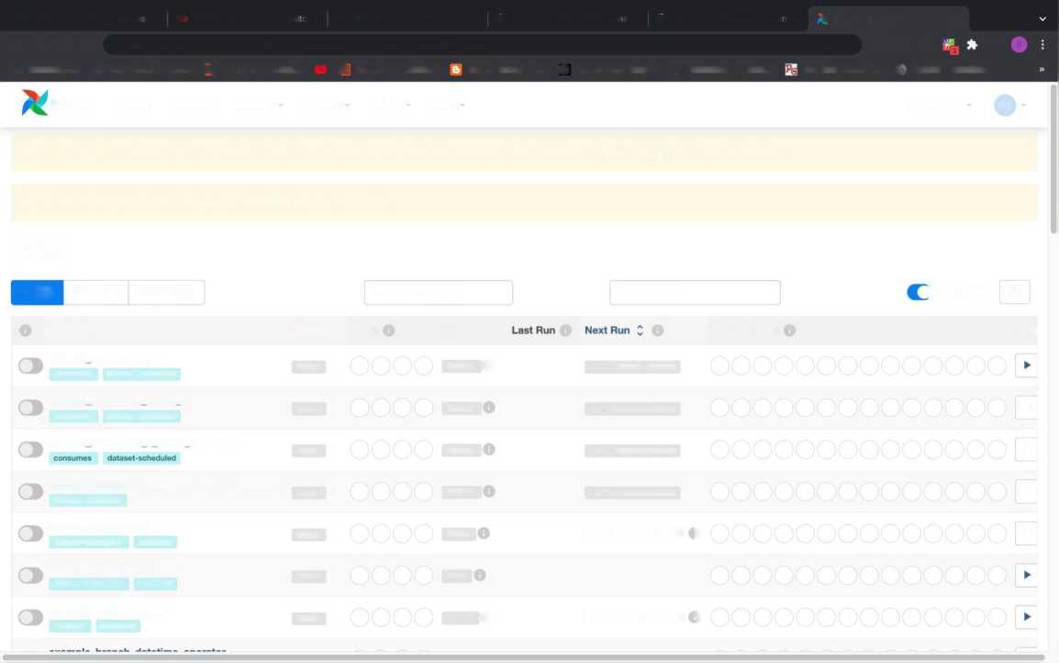
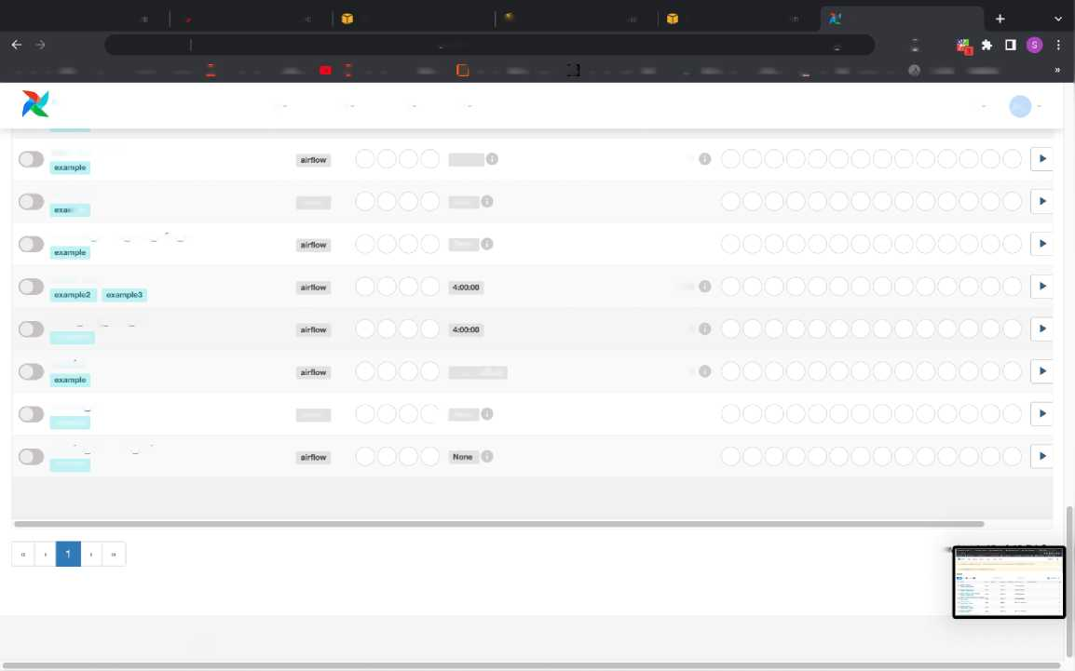
Airflow home screen:
CO beforeraw.ipynb - Colabor x I Z^{r} AfterLat.ipynb - Colabora x 0 EC2 Management Console x |j| Instance details | EC2 Mar x |j| Subnets | VPC Manageme x -v DAGs - Airflow X +
<- -> C Ci A Not Secure | ec2-44-204-123-51.compute-1.amazonaws.com:8080/home <>*(!]☆ # ffl B 0 ^{s}
K Novor6sum6 © 1905 bloody sund... [uij UiPath RPA Acade... ► [T UiPath RPA Acade... Top 20 String Alg... ^ Top 20 Java Interv... ■ Hierarchy of Selen... War and Peace, b... (f Ambari - Sandbox
Airflow DAGs Datasets Security Browse Admin Docs
02:38 UTC AU
Do not use SQLite as metadata DB in production - it should only be used for dev/testing. We recommend using Postgres or MySQL Click here for more information.
Do not use SequentialExecutor in production. Click here for more information.
DAGs
All© | Active O | Paused ^3 |  | Filter DAGs by tag |  | Search DAGs
) Auto-refresh C
Act
►
►
*
-
DAG Z
Owner Z Runs | Schedule
airflow | Dataset Q
airflow | Dataset
airflow | Dataset
airflow | Dataset
airflow | ©daily
airflow | None
airflow | 00-" O
Recent Tasks
dataset_consumes_1
0 of 1 datasets updated
consumes dataset-scheduled
dataset consumes Land 2
consumes dataset-scheduled
dataset consumes 1 never scheduled
dataset_consumes_unknown_never_scheduled
dataset-scheduled
dataset_produces_ 1 dataset-scheduled produces
0 of 2 datasets updated
0 of 2 datasets updated
0 of 2 datasets updated
2022-11-26,00:00:00 )
dataset _produces_2
dataset-scheduled produces
example_bash_operator
example example2
2022-11-26,00:00:00 )
CO beforeraw.ipynb - Colabor X CT AfterLat.ipynb - Colaborai X EC2 Management Console X |i Instance details | EC2 Man X Subnets | VPC Manageme X t DAGs - Airflow X
O Ci A Not Secure ec2-44-204-123-51.compute-1.amazonaws.com:8080/home Or (*j LV 9 18
N Novor6sum6 © 1905 bloody sund... lui] UiPath RPA Acade... ► (u| UiPath RPA Acade... |fi] Top 20 String Alg... 0 Top 20 Java Interv... SI Hierarchy of Selen... gB War and Peace, b... Ambari - Sandbox
Airflow DAGs Datasets Security Browse Admin Docs
02:38 UTC AU
example_xcom
©once
2021-01-01, 00:00:00
example_xcom_args
airflow
None
nple
exam pi e xc o m_a rgs w ith op er ato rs
None
latest_only
2022-11-26, 22:38:05
latest only with trigger
2022-11-26, 22:38:12
example3
tutorial
1 day, 0:30:00
2022-11-26, 02:37:49
tutorial dag
airflow
) |None
example
tuto na I taskflow api
example
Sho
Version: v2.4.3
Git Version: .release:2.4.3+c53a3e153f0ab5ca933a94adc01dc6314ea8d4d1

Slide 12
We can see a lot of API call time stamp on our terminal which indicates that the communication has been established.
ntosh; Intel Mac OS X 10_15_7) AppleWebKit/537.36 (KHTML, like Gecko) Chrome/107.0.0.0 Safari/537.36"
Webserver | 70.26.24.31 -- [27/Nov/2022:02:38:24 +0000] “GET /static/appbuilder/datepicker/bootstrap-datepicker.css HTTP/1.1" 304 0 “http://ec2-44-204-123-51.compute-1.amazonaws.com:8080/home" "Mozill
a/5.0 (Macintosh; Intel Mac OS X 10_15_7) AppleWebKit/537.36 (KHTML, like Gecko) Chrome/107.0.0.0 Safari/537.36"
Webserver | 70.26.24.31 - - [27/Nov/2022:02:38:24 +0000] "GET /static/dist/airflowDefaultTheme.731e57571b52cca4350d.css HTTP/1.1" 304 0 "http://ec2-44-204-123-51.compute-1.amazonaws.com:8080/home" "Moz illa/5.0 (Macintosh; Intel Mac OS X 10_15_7) AppleWebKit/537.36 (KHTML, like Gecko) Chrome/107.0.0.0 Safari/537.36"
Webserver | 70.26.24.31 -- [27/Nov/2022:02:38:24 +0000] "GET /static/appbuilder/css/flags/flagsl6.css HTTP/1.1" 304 0 "http://ec2-44-204-123-51.compute-1.amazonaws.com:8080/home" "Mozilla/5.0 (Macinto
sh; Intel Mac OS X 10_15_7) AppleWebKit/537.36 (KHTML, like Gecko) Chrome/107.0.0.0 Safari/537.36"
Webserver | 70.26.24.31 -- [27/Nov/2022:02:38:24 +0000] "GET /static/dist/materiallcons.f9559e4953177b8b9a4a.css HTTP/1.1" 304 0 "http://ec2-44-204-123-51.compute-1.amazonaws.com:8080/home" "Mozilla/5
.0 (Macintosh; Intel Mac OS X 10_15_7) AppleWebKit/537.36 (KHTML, like Gecko) Chrome/107.0.0.0 Safari/537.36"
Webserver | 70.26.24.31 -- [27/Nov/2022:02:38:24 +0000] "GET /static/dist/main.a53ccbaa4ca384c91837.css HTTP/1.1" 304 0 *http://ec2-44-204-123-51.compute-1.amazonaws.com:8080/home" "Mozilla/5.0 (Macin
tosh; Intel Mac OS X 10_15_7) AppleWebKit/537.36 (KHTML, like Gecko) Chrome/107.0.0.0 Safari/537.36"
Webserver | 70.26.24.31 - - [27/Nov/2022:02:38:24 +0000] "GET /static/appbuilder/css/ab.css HTTP/1.1" 304 0 "http://ec2-44-204-123-51.compute-1.amazonaws.com:8080/home" "Mozilla/5.0 (Macintosh; Intel M ac OS X 10_15_7) AppleWebKit/537.36 (KHTML, like Gecko) Chrome/107.0.0.0 Safari/537.36"
Webserver | 70.26.24.31 - - [27/Nov/2022:02:38:24 +0000] "GET /static/dist/loadingDots.5da42d00b5455806e709.css HTTP/1.1" 304 0 "http://ec2-44-204-123-51.compute-1.amazonaws.com:8080/home" "Mozilla/5.0 (Macintosh; Intel Mac OS X 10_15_7) AppleWebKit/537.36 (KHTML, like Gecko) Chrome/107.0.0.0 Safari/537.36"
Webserver | 70.26.24.31 -- [27/Nov/2022:02:38:24 +0000] "GET /static/dist/bootstrap-datetimepicker.min.css HTTP/1.1" 304 0 "http://ec2-44-204-123-51.compute-1.amazonaws.com:8080/home" "Mozilla/5.0 (Ma
cintosh; Intel Mac OS X 10_15_7) AppleWebKit/537.36 (KHTML, like Gecko) Chrome/107.0.0.0 Safari/537.36"
Webserver | 70.26.24.31 - - [27/Nov/2022:02:38:24 +0000] “GET /static/appbuilder/js/ab_filters.js HTTP/1.1" 304 0 "http://ec2-44-204-123-51.compute-1.amazonaws.com:8080/home" "Mozilla/5.0 (Macintosh; I ntel Mac OS X 10_15_7) AppleWebKit/537.36 (KHTML, like Gecko) Chrome/107.0.0.0 Safari/537.36"
Webserver | 70.26.24.31 - - [27/Nov/2022:02:38:24 +0000] "GET /static/appbuilder/js/ab_actions.js HTTP/1.1" 304 0 "http://ec2-44-204-123-51.compute-1.amazonaws.com:8080/home" "Mozilla/5.0 (Macintosh; I ntel Mac OS X 10_15_7) AppleWebKit/537.36 (KHTML, like Gecko) Chrome/107.0.0.0 Safari/537.36"
Webserver | 70.26.24.31 - - [27/Nov/2022:02:38:24 +0000] "GET /static/dist/flash.2bla873e0aabc828al65.css HTTP/1.1" 304 0 "http://ec2-44-204-123-51.compute-1.amazonaws.com:8080/home" "Mozilla/5.0 (Maci ntosh; Intel Mac OS X 10_15_7) AppleWebKit/537.36 (KHTML, like Gecko) Chrome/107.0.0.0 Safari/537.36"
Webserver | 70.26.24.31 - - [27/Nov/2022:02:38:24 +0000] "GET /static/appbuilder/js/bootstrap.min.js HTTP/1.1" 304 0 "http://ec2-44-204-123-51.compute-1.amazonaws.com:8080/home" "Mozilla/5.0 (Macintosh ; Intel Mac OS X 10_15_7) AppleWebKit/537.36 (KHTML, like Gecko) Chrome/107.0.0.0 Safari/537.36"
Webserver | 70.26.24.31 - - [27/Nov/2022:02:38:24 +0000] "GET /static/appbuilder/datepicker/bootstrap-datepicker.js HTTP/1.1" 304 0 “http://ec2-44-204-123-51.compute-1.amazonaws.com:8080/home" "Mozilla /5.0 (Macintosh; Intel Mac OS X 10_15_7) AppleWebKit/537.36 (KHTML, like Gecko) Chrome/107.0.0.0 Safari/537.36"
Webserver | 70.26.24.31 -- [27/Nov/2022:02:38:24 +0000] "GET /static/appbuilder/select2/select2.js HTTP/1.1" 304 0 "http://ec2-44-204-123-51.compute-1.amazonaws.com:8080/home" "Mozilla/5.0 (Macintosh;
Intel Mac OS X 10_15_7) AppleWebKit/537.36 (KHTML, like Gecko) Chrome/107.0.0.0 Safari/537.36"
Webserver | 70.26.24.31 - - [27/Nov/2022:02:38:24 +0000] "GET /static/appbuilder/js/ab.js HTTP/1.1" 304 0 "http://ec2-44-204-123-51.compute-1.amazonaws.com:8080/home" "Mozilla/5.0 (Macintosh; Intel Mac OS X 10_15_7) AppleWebKit/537.36 (KHTML, like Gecko) Chrome/107.0.0.0 Safari/537.36"
Webserver J 70.26.24.31 - - [27/Nov/2022:02:38:24 +0000] "GET /static/dist/moment.l97a6f3cab42e240f8bd.js HTTP/1.1" 304 0 "http://ec2-44-204-123-51.compute-1.amazonaws.com:8080/home" "Mozilla/5.0 (Maci ntosh; Intel Mac OS X 10_15_7) AppleWebKit/537.36 (KHTML, like Gecko) Chrome/107.0.0.0 Safari/537.36"
Webserver | 70.26.24.31 -- [27/Nov/2022:02:38:24 +0000] "GET /static/appbuilder/js/jquery-latest.js HTTP/1.1" 304 0 “http://ec2-44-204-123-51.compute-1.amazonaws.com:8080/home" "Mozilla/5.0 (Macintosh
; Intel Mac OS X 10_15_7) AppleWebKit/537.36 (KHTML, like Gecko) Chrome/107.0.0.0 Safari/537.36"
Webserver | 70.26.24.31 - - [27/Nov/2022:02:38:24 +0000] "GET /static/dist/main.a53ccbaa4ca384c91837.js HTTP/1.1" 304 0 "http://ec2-44-204-123-51.compute-1.amazonaws.com:8080/home" "Mozilla/5.0 (Macint osh; Intel Mac OS X 10_15_7) AppleWebKit/537.36 (KHTML, like Gecko) Chrome/107.0.0.0 Safari/537.36"
Webserver | 70.26.24.31 - - [27/Nov/2022:02:38:24 +0000] "GET /static/dist/bootstrap-datetimepicker.min.js HTTP/1.1" 304 0 "http://ec2-44-204-123-51.compute-1.amazonaws.com:8080/home" "Mozilla/5.0 (Mac intosh; Intel Mac OS X 10_15_7) AppleWebKit/537.36 (KHTML, like Gecko) Chrome/107.0.0.0 Safari/537.36"
Webserver | 70.26.24.31 - - [27/Nov/2022:02:38:24 +0000] "GET /static/dist/bootstrap3-typeahead.min.js HTTP/1.1" 304 0 "http://ec2-44-204-123-51.compute-1.amazonaws.com:8080/home" "Mozilla/5.0 (Macinto sh; Intel Mac OS X 10_15_7) AppleWebKit/537.36 (KHTML, like Gecko) Chrome/107.0.0.0 Safari/537.36"
Webserver | 70.26.24.31 - - [27/Nov/2022:02:38:24 +0000] "GET /static/dist/dags.6002dfe5596301728dl0.js HTTP/1.1" 200 0 "http://ec2-44-204-123-51.compute-1.amazonaws.com:8080/home" "Mozilla/5.0 (Macint osh; Intel Mac OS X 10_15_7) AppleWebKit/537.36 (KHTML, like Gecko) Chrome/107.0.0.0 Safari/537.36"
Webserver | 70.26.24.31 - - [27/Nov/2022:02:38:24 +0000] “GET /static/dist/d3.min.js HTTP/1.1" 200 0 "http://ec2-44-204-123-51.compute-1.amazonaws.com:8080/home" "Mozilla/5.0 (Macintosh; Intel Mac OS X 10_15_7) AppleWebKit/537.36 (KHTML, like Gecko) Chrome/107.0.0.0 Safari/537.36"
Webserver | 70.26.24.31 - - [27/Nov/2022:02:38:25 +0000] "POST /blocked HTTP/1.1" 200 2 "http://ec2-44-204-123-51.compute-1.amazonaws.com:8080/home" "Mozilla/5.0 (Macintosh; Intel Mac OS X 10_15_7) App leWebKit/537.36 (KHTML, like Gecko) Chrome/107.0.0.0 Safari/537.36"
Webserver | 70.26.24.31 - - [27/Nov/2022:02:38:25 +0000] "POST /dag_stats HTTP/1.1" 200 6595 "http://ec2-44-204-123-51.compute-1.amazonaws.com:8080/home" "Mozilla/5.0 (Macintosh; Intel Mac OS X 10_15_7 ) AppleWebKit/537.36 (KHTML, like Gecko) Chrome/107.0.0.0 Safari/537.36"
Webserver | 70.26.24.31 - - [27/Nov/2022:02:38:25 +0000] "POST /last_dagruns HTTP/1.1" 200 2 "http://ec2-44-204-123-51.compute-1.amazonaws.com:8080/home" "Mozilla/5.0 (Macintosh; Intel Mac OS X 10_15_7 ) AppleWebKit/537.36 (KHTML, like Gecko) Chrome/107.0.0.0 Safari/537.36"
Webserver | 70.26.24.31 - - [27/Nov/2022:02:38:25 +0000] "POST /task_stats HTTP/1.1" 200 21195 "http://ec2-44-204-123-51.compute-1.amazonaws.com:8080/home" "Mozilla/5.0 (Macintosh; Intel Mac OS X 10_15 _7) AppleWebKit/537.36 (KHTML, like Gecko) Chrome/107.0.0.0 Safari/537.36"
Webserver | 70.26.24.31 - - [27/Nov/2022:02:38:25 +0000] "GET /object/next_run_datasets/dataset_consumes_l_and_2 HTTP/1.1" 200 117 "http://ec2-44-204-123-51.compute-1.amazonaws.com:8080/home" "Mozilla/
5.0 (Macintosh; Intel Mac OS X 10_15_7) AppleWebKit/537.36 (KHTML, like Gecko) Chrome/107.0.0.0 Safari/537.36"
Webserver | 70.26.24.31 - - [27/Nov/2022:02:38:26 +0000] "GET /object/next_run_datasets/dataset_consumes_l HTTP/1.1" 200 59 "http://ec2-44-204-123-51.compute-1.amazonaws.com:8080/home" "Mozilla/5.0 (Ma cintosh; Intel Mac OS X 10_15_7) AppleWebKit/537.36 (KHTML, like Gecko) Chrome/107.0.0.0 Safari/537.36"
Webserver | 70.26.24.31 - - [27/Nov/2022:02:38:26 +0000] "GET /object/next_run_datasets/dataset_consumes_l_and_2 HTTP/1.1" 200 117 "http://ec2-44-204-123-51.compute-1.amazonaws.com:8080/home" "Mozilla/
5.0 (Macintosh; Intel Mac OS X 10_15_7) AppleWebKit/537.36 (KHTML, like Gecko) Chrome/107.0.0.0 Safari/537.36"
Webserver | 70.26.24.31 -- [27/Nov/2022:02:38:26 +0000] "GET /object/next_run_datasets/dataset_consumes_l_and_2 HTTP/1.1" 200 117 "http://ec2-44-204-123-51.compute-1.amazonaws.com:8080/home" "Mozilla/
5.0 (Macintosh; Intel Mac OS X 10_15_7) AppleWebKit/537.36 (KHTML, like Gecko) Chrome/107.0.0.0 Safari/537.36"
| [ ] { 1380} INFO - Resetting orphaned tasks for active dag runs

Slide 13

Code of our local which need to transferred to AWS airflow:
EXPLORER | *e* sns.py • *«* twitter_dag.py 3 • |  | V < B
) BIGDATAPROJECT | twitter_dag.py >...
O > OUTLINE | l | from datetime import timedelta
/ > TIMELINE | 2 | from airflow import DAG
 | 3 | from airfTow.ojaerat: ors.pytho^operator import PythoriOperator
 | 4 | from airflow.utils.dates import days_ago
 | 5 | from datetime import datetime
er* | 6 7 | from sns import run_twitter_etl
 | 8 | default_args = -(
QD | 9 | 'owner': 'airflow',
tb | 10 | 'depends_on_past¹: False,
 | 11 | ¹start_date': datetime(2020, 11, 8),
A | 12 | ‘email': l 'airf lowtaexample.com' ],
 | 13 | 'email_on_failure’: False,
rsi, | 14 | ’email_on_retry': False,
O | 15 | 'retries': 1,
 | 16 | 'retry_delay': timedelta(minutes=l)
 | 17 | >
 | 18
 | 19 | dag = DAG(
 | 20 | 'twitter_dag',
 | 21 | default_args=default_args,
 | 22 | description^My first etl code'
 | 23 | )
 | 24
 | 25 | run_etl = PythonOperatorl
 | 26 | task_id='complete_twitter_etl‘,
 | 27 | python_callable=run_twitter_etl,
 | 28 | dag-dag,
 | 29 | )
 | 30
 | 31 | run_et l|
 | PROBLEMS ^ OUTPUT DEBUG CONSOLE TERMINAL JUPYTER |  | + V /N X
 | /usr/local/bin/python3 /Users/saisahu/Desktop/Bigdataproject/twitter dag.py |  | [>] zsh
 | ® (base) | saisahu(3sais-MacBook-Air Bigdataproject % /usr/local/bin/python3 /Users/saisahu/Desktop/Bigdataproject/twitter_dag.py | ^ (3 Python
 | Traceback (most recent call last):
 | File | "/Users/saisahu/Desktop/Bigdataproject/twitter_dag.py", line 2, in <module>
 | from airflow import DAG
 | ModuleNotFoundError: No module named 'airflow' |  | ■
 | o (base) | saisahu@sais-MacBook-Air Bigdataproject % | I
® |  | 0 The Marketplace has extensions that can help with '.csv' files X
 |  | Search Marketplace | Don't Show Again for '.csv' files
©
® 0 A3 |  | Ln 31, Col 8 Spaces: A UTF-8 LF | tt Python 3.10,7 64-bit P? C?
Creating a S3 bucket in AWS:
00 beforeraw.ipynb - Colabor x 30 AfterLat.ipynb - Colabors x ^ S3 Management Console x |ji Instance details | EC2 Man x Subnets | VPC Manageme x & DAGs - Airflow x +
<- -> C O i $3.console.aws.amazon.com/s3/get-started?region=us-east-1 © <s * • » * * □
^ Novor6sum6 @ 1905 bloody sund... [U{] UiPath RPA Acade... ► [Uj] UiPath RPA Acade... ft Top 20 String Alg... if" Top 20 Java Interv... 51 Hierarchy of Selen... j^j War and Peace, b... Ambari - Sandbox
^ :£! Services Q. Search_[Qption+S] j
0 ^ © Global v saisahu ▼
0 We're continuing to improve the S3 console to make it faster and easier to use. If you have feedback on the updated experience, choose Provide feedback.
Provide feedback
Amazon S3
Store and retrieve any amount of data from anywhere
Amazon S3 is an object storage service that offers industry-leading scalability, data availability, security, and performance.
Create a bucket
Every object in S3 is stored in a bucket. To upload files and folders to S3, you'll need to create a bucket where the objects will be stored.
How it works
With S3, there are no minimum fees. You only pay for what you use. Prices are based on the location of your S3 bucket.
Estimate your monthly bill using the AWS
Simple Monthly Calculator
View pricing details K
Resources 03
2022, Amazon Internet Services Private Ltd. or Its affiliates. Privacy Terms Cookie prefere

Slide 14
A universal bucket named bigdataprojectlambton is created:
00 beforeraw.ipynb - Colabor X AfterLat.ipynb - Colabora X £ S3 Management Console X |j| Instance details | EC2 Mar X If Subnets | VPC Manageme X A? DAGs - Airflow
a* i i r_{B} f » □ s ■
<- -> C A s3.console.aws.amazon.com/s3/buckets?region=us-east-1
K Novor6sum6 @ 1905 bloody sund... [u UiPath RPA Acade... :i; Services Q. Search
UiPath RPA Acade... Top 20 String Alg... 0 Top 20 Java Interv... ■ Hierarchy of Selen... War and Peace, b... ft Ambari - Sandbox »
[Option+S] I 0 ^ @ Global ▼ saisahu ▼
Amazon S3
Buckets Access Points
Object Lambda Access Points Multi-Region Access Points Batch Operations Access analyzer for S3
Block Public Access settings for this account
▼ Storage Lens
Dashboards
AWS Organizations settings Feature spotlight ► AWS Marketplace for S3
0 We're continuing to improve the S3 console to make it faster and easier to use. If you have feedback on the updated experience, choose Provide feedback.
Provide feedback
0 Successfully created bucket "bigdataprojectlambton"
To upload files and folders, or to configure additional bucket settings choose View details.
0 Easily transfer data between AWS Storage services with AWS DataSync.
Amazon S3 > Buckets
► Account snapshot
Storage lens provides visibility into storage usage and activity trends. Learn more Q5
View Storage Lens dashboard
Buckets (1) info
Buckets are containers for data stored in S3. Learn more a
O 0 Copy ARN Empty Delete
Q. Find buckets by name
< 1 > ©
Name A AWS Region v Access v Creation date
bigdataprojectlambton US East (N. Virginia) us-east-1 Bucket and objects not public November 26, 2022, 21:51:48 (UTC-05:00)
Feedback Looking for language selection? Find it in the new Unified Settings Q5
© 2022, Amazon Internet Services Private Ltd. or its affiliates. Privacy Terms Cookie preferences
Open a duplicate terminal to code in airflow:
• Terminal Shell Edit View Window Help
Sat Nov 26 9:55 PM
Downloads — ubuntu@ip-172-31-13-219:--ssh -i bigdataproject.pem ub...
□ □ ■ *
datasets/dataset_consumes_l_and_2 HTTP/1.1" 200 117 "http://ec2-44-204-123-51.co mpute-1.amazonaws.com:8080/home" "Mozilla/5.0 (Macintosh; Intel Mac OS X 10_15_7 ) AppleWebKit/537.36 (KHTML, like Gecko) Chrome/107.0.0.0 Safari/537.36"
Screen Shot
Screen Shot
Visual Studio for Mac Installer
Webserver | 70.26.24.31 - - [27/Nov/2022:02:38:26 +0000] "GET /object/next_run_ datasets/dataset_consumes_l HTTP/1.1" 200 59 "http://ec2-44-204-123-51.compute-1 .amazonaws.com:8080/home" "Mozilla/5.0 (Macintosh; Intel Mac OS X 10_15_7) Apple WebKit/537.36 (KHTML, like Gecko) Chrome/107.0.0.0 Safari/537.36"
2022-11...0.58 PM 2022-11...10.44 PM
□ ■
Webserver | 70.26.24.31 -- [27/Nov/2022:02:38:26 +0000] "GET /object/next_run_
) AppleWebKit/537.36 (KHTML, like O # # Downloads — ubuntu@ip-172-31-13-219:- — ssh -i bigdataproject.pem ub... Webserver | 70.26.24.31 - - [27/
datasets/dataset.consumes 1 and_2^{l(base)} saisahu(?sais-MacBook-Air ~ X cd downloads
mpute-1.amazonaws.com:8080/home" I (base) saisahu(?sais-MacBook-Air downloads X ssh -i "bigdataproject.pem" ubuntupe! ) AppleWebKit/537.36 (KHTML, like C2-44-204-123-51.compute-1.amazonaws.com
■
Lambton
■
| [ Welcome to Ubuntu 22.04.1 LTS (GNU/Linux 5.15.0-1019-aws x86_64)
orphaned tasks for active dag run
scheduler | 12022-11-27 02:4! orphaned tasks for active dag run scheduler | [2022-11-27 02:50 orphaned tasks for active dag run | [2022-11-27 02:53:49 Webserver | [2022-11-27 02:53:49
D
* Documentation:
* Management:
* Support:
https://help.ubuntu.com
https://landscape.canonical.com
https://ubuntu.com/advantage
System information as of Sun Nov 27 02:55:23 UTC 2022
System load: 0.3076171875 Usage of /: 30.8X of 7.57GB
Memory usage: 36X Swap usage: 0X
Processes: 117
Users logged in: 1
IPv4 address for ens5: 172.31.13.219
My Information Screen Shot and RoadMap
79 updates can be applied immediately.
47 of these updates are standard security updates.
To see these additional updates run: apt list —upgradable
12 PM 2022-11...2.36 PM
Last login: Sun Nov 27 02:04:46 2022 from 70.26.24.31
ubuntu@ip-172-31-13-219: -$ |
ot Screen Shot Screen Shot
.....~*30PM 2022-11...2.52 PM 2022-11...0.46 PM
Screen Shot Screen Shot Screen Shot
2022-11...8.35 PM 2022-11...4.49 PM 2022-11...01.07 PM
□ □ B
Screen Shot Screen Shot Screen Shot
2022-11...41.22 PM 2022-11...10.26 PM 2022-11...01.24 PM
*tv f]
O
.ill / A

Slide 15
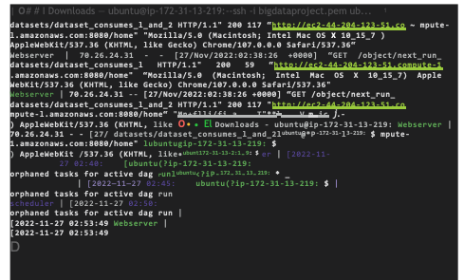
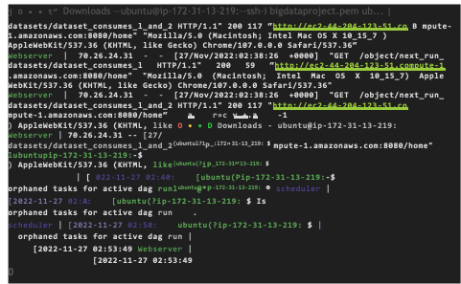
• Terminal Shell Edit View Window Help
□ n
Screen Shot Screen Shot
2022-11...0.58 PM 2022-11...10.44 PM
Visual Studio for Mac Installer
- — ssh -i bigdataproject.pem ub... _{ot}
' ot | Bigdataproject | demol.xlsx
l H11 PM I ] |  | ■
Ot |  | Lambton
:4 PM j | m | ■
Ot | Screen Shot | My Information and RoadMap
12 PM | 2022-11...2.36 PM
 | H | ^8
ot | Screen Shot | Screen Shot
o.30 PM | 2022-11...2.52 PM | 2022-11...0.46 PM
i | □
Shot | Screen Shot | Screen Shot
□ □
180 Pa
/ A
00^0^ 0© ■ ^{v}
• Terminal Shell Edit View Window Help
C * © B* ? Q £ # Sat Nov 26 9:55 PM
□ □
Screen Shot Screen Shot
2022-11...0.58 PM 2022-11...10.44 PM
Visual Studio for Mac Installer
--ssh -i bigdataproject.pem ub...
ot | Bigdataproject | demol.xlsx
a n PM ] |  | ■
ot |  | Lambton
14 PM | | m | m
 |  | My Information
jot | Screen Shot | and RoadMap
12 PM | 2022-11...2.36 PM
I | B | B
ot | Screen Shot | Screen Shot
.30 PM | 2022-11...2.52 PM | 2022-11...0.46 PM
i | □
Ihot | Screen Shot | Screen Shot
□ □

Slide 16
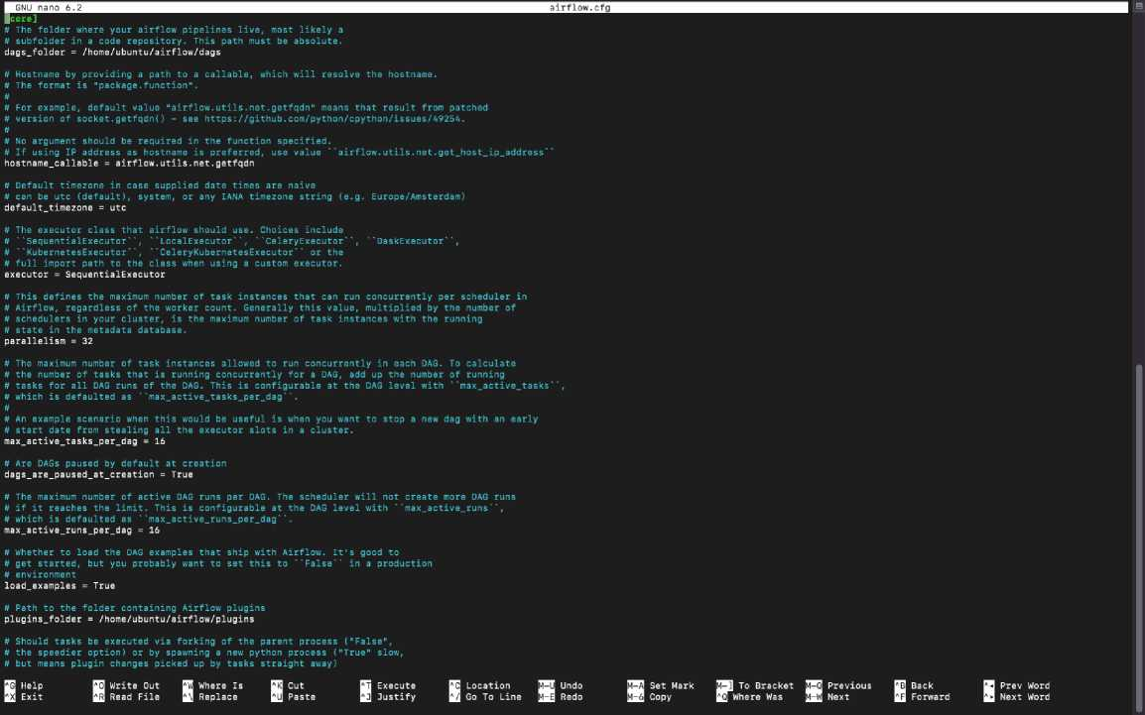
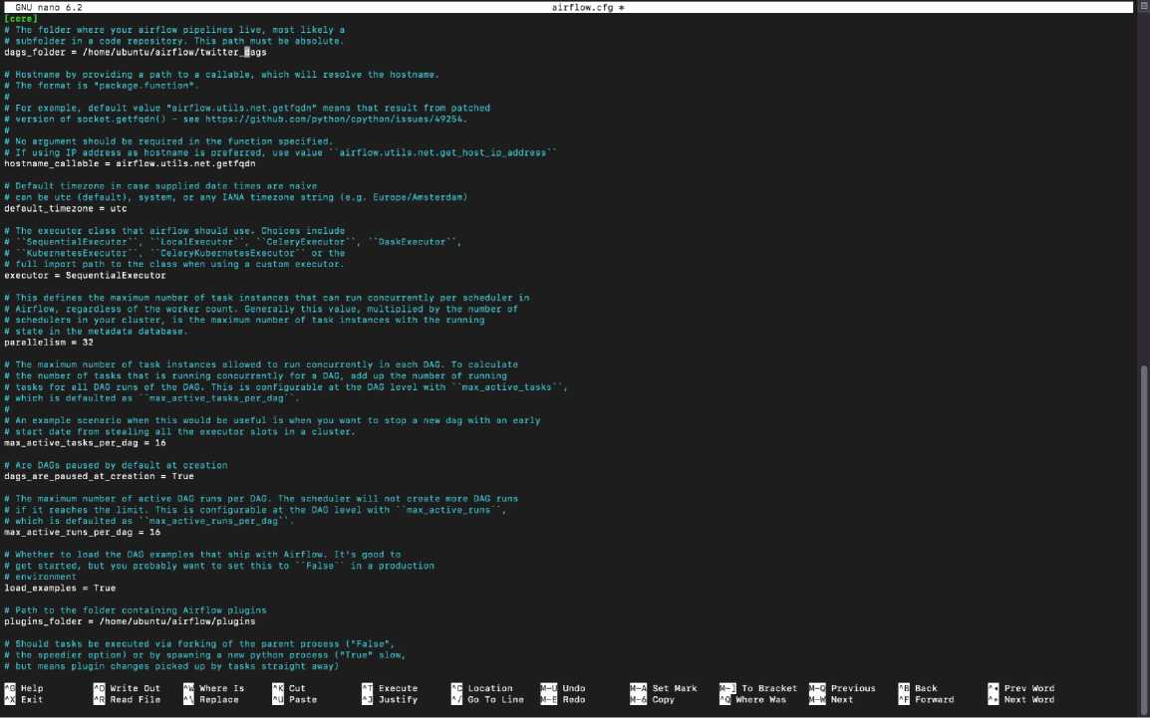

Slide 17
[ubuntupip-172-31-13-219: $ ] [■
[ubuntupip-172-31-13-219:-S ]
[ubuntugip-172-31-13-219: S
[ubuntu(?ip-172-31-13-219:-S 1
[ubuntugip-172-31-13-219: S ]
[ubuntu(?ip-172-31-13-219: S Is I
[ubuntu(?ip-172-31-13-219: $ cd airflow
[ubuntu(?ip-172-31-13-219: - /airflow} Is 1
airflow-webserver.pid airflow.db standalone_admin_password.txt airflow.cfg logs webserver.config.py
[ubuntu(?ip-172-31-13-219: $ sudo nano airflow.cfg
[ubuntu(?ip-172-31-13-219: $ sudo nano airflow.cfg
ubuntu(?ip-172-31-13-219: S clearf
Creating a dag file named twitter.dag
[ubuntu(?ip-172-31-13-219:-/airflows mkdir twitter_dag Iubuntu@ip-172-31-13-219:-/airflow* Is
airflow-webserver.pid airflow.cfg airflow.db standalone_admin_password.txt webserver_config.py
ubuntu@ip-172-31-13-219:-/airflow$ |

Slide 18
Q
p
EXPLORER
> BIGDATAPROJECT
> OUTLINE
> TIMELINE
•& sns.py
«S* twitter_dag.py 2
•** sns.py > ® run_twitter_etl
1 import pandas as pd
2 import snscrape.modules.twitter as sntwitter
3
4 def run_twitter_etl();
5
6 limit = 500
7 query = "Lambton" tweet_!ist = []
a?
K
0
11 for tweets in sntwitter.TwitterSearehScraper(query).get_items():
12
13 if len(tweet_list)“limit:
14 break
15 else:
16 tweet_list.append([tweets.date,tweets.use r.username,tweets.content])
17
18 #Airflow is ready
19 fstandalone | Login with username: admin password: dkqWhkVQKtnXygGg
20
df = pd,DataFrame(tweet_list,columns=['date','User'j'Tweet'!)
print(df)
df.to_csv("s3://bigdataprojectlambton/Bigdata.csv")
29
30
PROBLEMS 3 OUTPUT DEBUG CONSOLE TERMINAL JUPYTER
+ - ' □ zsh [D Python
/usr/local/bin/python3 /users/saisahu/Desktop/Bigdataproject/twitter_dag.py ® (base) saisahiKPsais-MacBook-Air Bigdataproject % /usr/local/bin/python3 /Users/saisahu/Desktop/Bigdataproject/twitter_dag.py Traceback (most recent call last):
File '7Users/saisahu/Desktop/Bigdataproject/twitter_dag.py", line 2, in <module> from airflow import OAG ModuleNotFoundError: No module named 'airflow'
O (base) saisahu@sais-MacBook-Air Bigdataproject %
© The Marketplace has extensions that can help with '.csv' files X Search Marketplace Don't Show Again for '.csv' files
Ln 18, Col 22 Spaces: 4 UTF-8 LF {J Python 3.10.7 64-bit C?
Loading the SNS.py file from local to Airflow:
ubuntupip-172-31-13-219: $ mkdir twitter_dag
ubuntupip-172-31-13-219: $ Is
standalone_admin_password.txt
webserver_config.py
airflow-webserver.pid airflow.cfg airflow.db
[ubuntupip-172-31-13-219: [ ubuntupip-172-31-13-219: [ubuntuPip-172-31-13-219: twitter_dag.py [ubuntupip-172-31-13-219: lubuntuPip-172-31-13-219: sns.py twitter_dag.py ubuntupip-172-31-13-219:
$ cd twitter_dag
$ sudo nano twitter_dag.py tte S Is
iw/twitto: dag$ Is
S sudo nano sns.py
,/rtitt.r.d.s* |

Slide 19
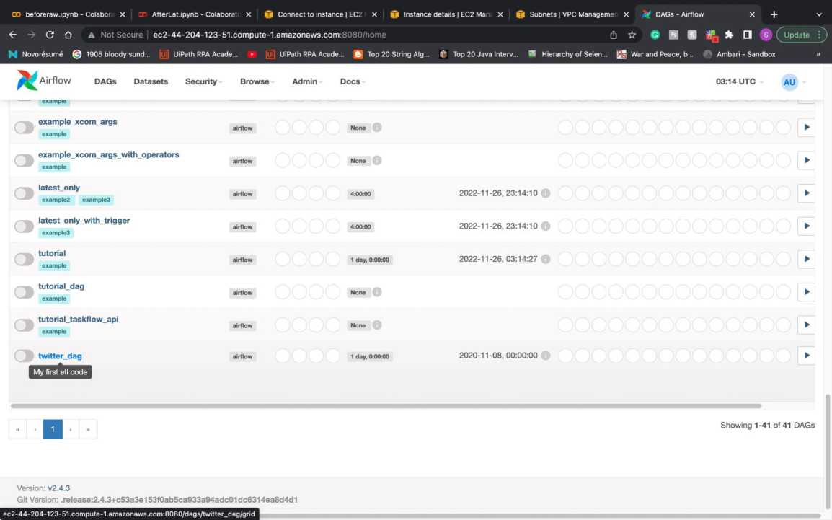
i(base) saisahu(?sais-MacBook-Air downloads % ssh -i "bigdataproject.pern" ubuntu9ec2-44-2e4-123-51.compute-l.amazonaws.com Welcome to Ubuntu 22.04.1 LTS (GNU/Linux 5.15.0-1019-aws x86_64)
* Documentation: https://help.ubuntu.com
* Management: https://landscape.canonical.com
* Support: https://ubuntu.com/advantage
System information as of Sun Nov 27 03:10:56 UTC 2022
System load: 0.3291015625 Processes: 119
Usage of /: 30.8% of 7.57GB Users logged in: 1
Memory usage: 37% IPv4 address for ens5: 172.31.13.219
Swap usage: 0%
79 updates can be applied immediately.
47 of these updates are standard security updates.
To see these additional updates run: apt list —upgradable
Last login: Sun Nov 27 02:55:23 2022 from 70.26.24.31 ubuntu(?ip-172-31-13-219: $ cd (ubuntuPip-172-31-13-219: $ cd airflow
[ubuntutPip-172-31-13-219: S sudo nano airflow.cfg
ubuntupip-172-31-13-219: ubuntu(?ip-172-31-13-219: ubuntupip-172-31-13-219:
$ sudo nano airflow.cfg
s ■
Twitter_dag file is now displayed in airflow home screen:

Slide 20
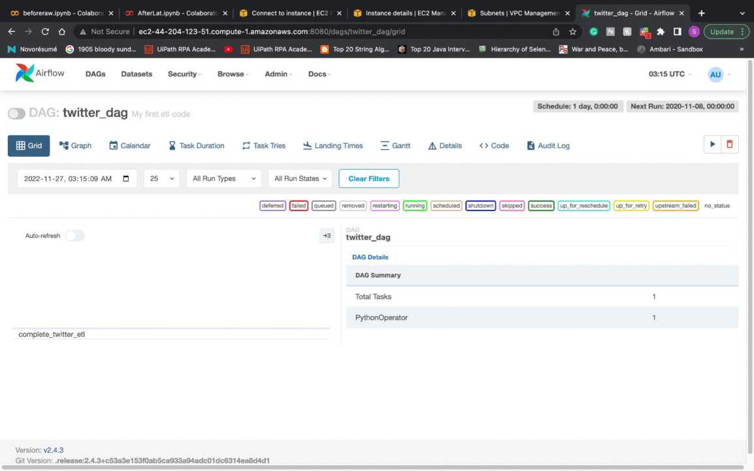
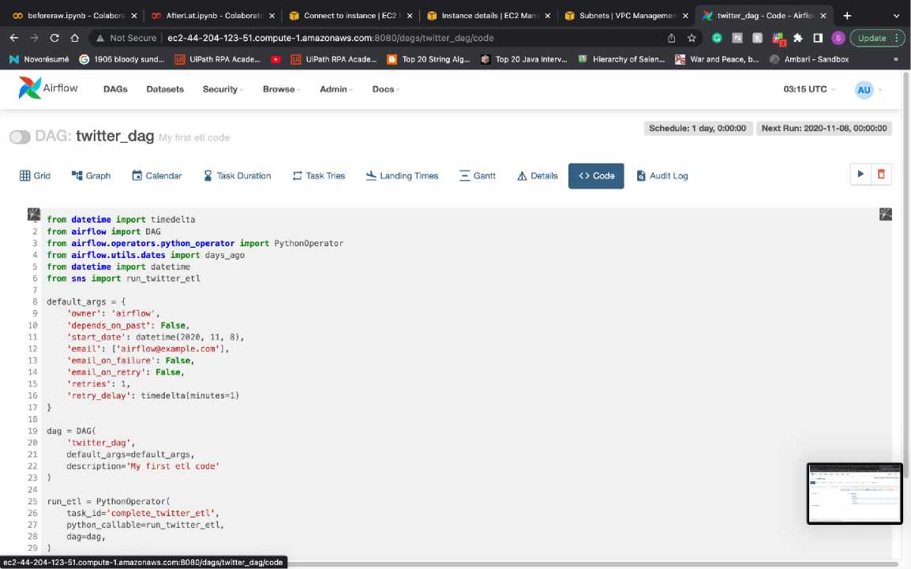
Code of twitter_dag file:

Slide 21
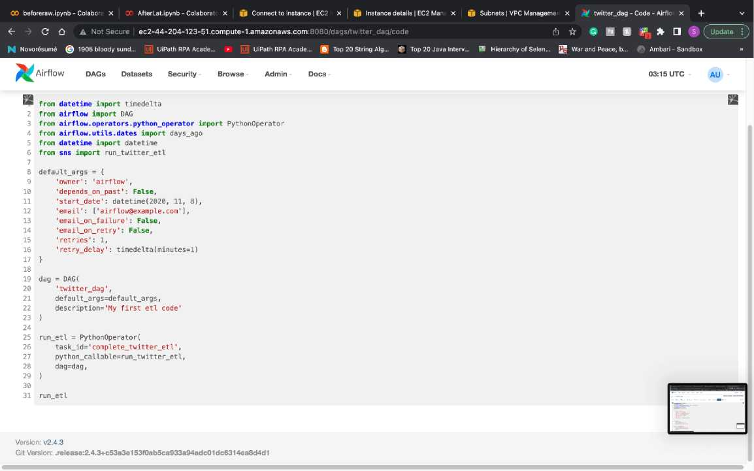
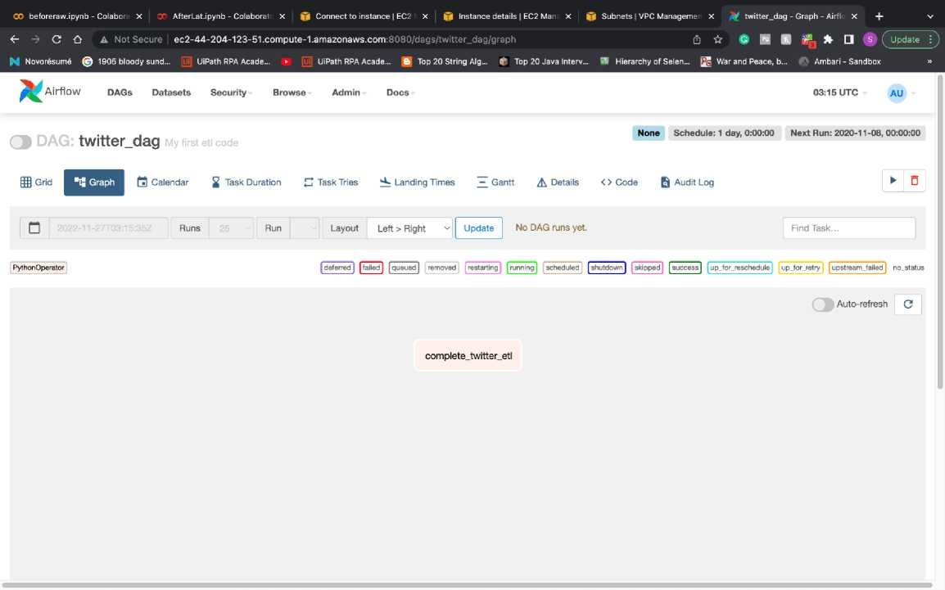
Executing the Dag file:

Slide 22
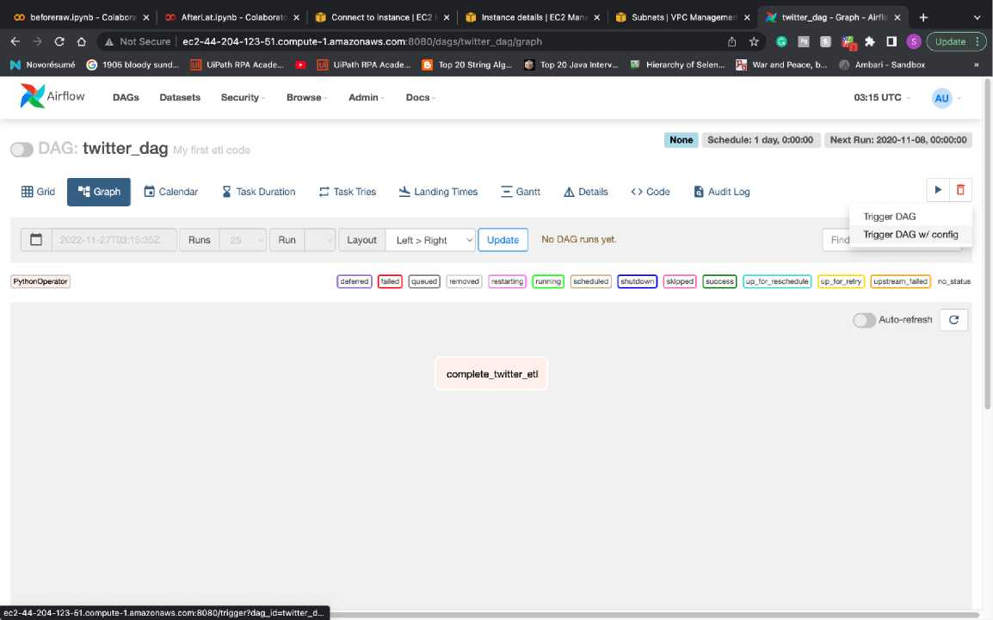
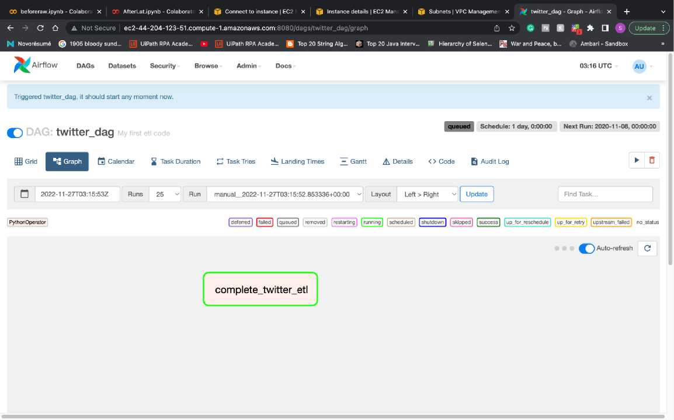
Execution is in process

Slide 23
Error: Due to IAM poly rule between EC2 and S3:
OO beforeraw.ipynb - Colabor x CT AfterLat.ipynb - Colaborai x ft Connect to instance | EC2 x ft Instance details | EC2 Man x ft Subnets | VPC Manageme x ^ twitter_dag - Airflow x + v
<r -> C A Not Secure | ec2-44-204-123-51.compute-1.amazonaws.com:8080/log?dag_id=twitter_dag&taskJd=complete_twitter_etl&exe... (h ft # H B ^ Update
^ Novo resume © 1905 bloody sund... UiPath RPA Acade... ► [Uj] UiPath RPA Acade... 0 Top 20 String Alg... 0 Top 20 Java Interv... SI Hierarchy of Selen... War and Peace, b... Ambari - Sandbox »
* Airflow
DAGs Datasets Security
*** Reading local file: /home/ubuntu/airf low/logs/dag_id=twitter_dag/run_id=manual_2022-11-27T03: 15:52.853336+00:00/task_id=complete_twitter_etl/attempt=l. log
[2022-11-27, 03:16:09 UTC] {taskinstance.py:1165} INFO - Dependencies all met for «TaskInstance: twitter_dag.complete_twitter_etl manual 2022-11-27T03:13:52.853336+00:00 [queuei
[2022-11-27, 03:16:09 UTC] {taskinstance.py:ll65} INFO - Dependencies all met for <TaskInstance: twitter_dag.complete_twitter_etl manual 2022-11-27T03:15:52.853336+00:00 [queuei
[2022-11-27, 03:16:09 UTC] {taskinstance.py:1362> INFO -
[2022-11-27, 03:16:09 UTC] {taskinstance.py:1363} INFO [2022-11-27, 03:16:09 UTC] {taskinstance.py:l364> INFO
Starting attempt 1 of 2
[2022-11-27, 03:16:09 UTC] {taskinstance.py:1383} INFO - Executing <Task(PythonOperator): complete_twitter_etl> on 2022-11-27 03:15:52.853336+00:00 [2022-11-27, 03:16:09 UTC] {standard_task_runner.py:55> INFO - Started process 7202 to run task
[2022-11-27, 03:16:09 UTC] {standard_task_runner.py:82} INFO - Running; ['airflow', 'tasks', 'run', 'twitter_dag‘, 'complete_twitter_etl¹, 'manual 2022-11-27T03:15:52.853336+00
[2022-11-27, 03:16:09 UTC] {standsrd_task_runner.py:83> INFO - Job 6: Subtask complete_twitter_etl
[2022-11-27, 03:16:09 UTC] {task_command.py:376> INFO - Running cTasklnstance: twitter_dag.complete_twitter_etl manual_2022-11-27T03:15:52.853336+00:00 [running]> on host ip—17i
[2022-11-27, 03:16:09 UTC] {taskinstance.py:1590} INFO - Exporting the following env vars:
AIRFLOW_CTX_DAG_EMAIL=airflow@example.com AIRFLOW_CTX_DAG_OWNER=airflow AIRFLOW_CTX_DAG_ID=twitter_dag AIRFLOW_CTX_TASK_ID=complete_twitter_etl AIRFLOW_CTX_EXECUTIQN_DATE=2022-11-27T03:15:52.853336+00:00 AIRFL0W_CTX_TRY_NUMBER=1
AIRFLOW_CTX_DAG_RUN_ID=manual_2022-ll-27T03:15:52.853336+00:00 [2022-11-27, 03:16:09 UTC] {twitter.py:368> INFO - Retrieving scroll page None [2022-11-27, 03:16:09 UTC] {twitter.py:300> INFO - Retrieving guest token
[2022-11-27, 03:16:09 UTC] {base.py:168} INFO - Retrieving https://twitter.com/search?f=live&lang=en£iq=Lambton&src=spelling_expansion_revert_click [2022-11-27, 03:16:09 UTC] {base.py:184} INFO - Retrieved https://twitter.com/search?f=live&lang=en&q=Lambton&isrc=spelling_expansion_revert_click: 200
[2022-11-27, 03:16:09 UTC] {base.py:168} INFO - Retrieving https://api.twitter.eom/2/search/adaptive.json?include_profile_interstitial_type=l&include_blocking=lSiinclude_blocked_l [2022-11-27, 03:16:09 UTC] {base.py:184} INFO - Retrieved https://api.twitter.eom/2/search/adaptive.json?include_profile_interstitiai_type=l&include_blocking=l&include_blocked_b; [2022-11-27, 03:16:09 UTC] {twitter.py:368} INFO - Retrieving scroll page scroll;thGAVUV0VFVBaOwNDJ3NixqCwWhMC4-fSFzagsEnEV8IV6FYCJehgHREVGQWWVDUBFQAVAAA=
[2022-11-27, 03:16:09 UTC] {base.py:168} INFO - Retrieving https://api.twitter.eom/2/search/adaptive.json?include_profile_interstitial_type=l&include_blocking=l£iinclude_blocked_l [2022-11-27, 03:16:10 UTC] {base.py:184} INFO - Retrieved https://api.twitter.com/2/search/adaptive.json?include_profile_interstitial_type=l&include_blocking=l&include_blocked_b; [2022-11-27, 03:16:10 UTC] {twitter.py:368} INFO - Retrieving scroll page scroll:thGAVUV0VFVBaAgL61mPWvqCwWhMC4-fSFzagsEnEV4IJ6FYCJehgHREVGQWMVDUBFQIVAAA=
[2022-11-27, 03:16:10 UTC] {base.py:l68} INFO - Retrieving https://api.twitter.eom/2/search/adaptive.json?include_profile_interstitial_type=l&include_blocking=l&include_blocked_l [2022-11-27, 03:16:10 UTC] {base.py:184} INFO - Retrieved https://api.twitter.eom/2/search/adaptive.json?include_profile_interstitial_type=l&include_{=blocking=l&include_blocked_b}; [2022-11-27, 03:16:10 UTC] {twitter.py:368} INFO - Retrieving scroll page scroll:thGAVUV0VFVBaAgNDJ4ZmhqCwWhMC4-fSFzagsEnEVyIB6FYCJehgHREVGQWMVDUBFQQVAAA=
[2022-11-27, 03:16:10 UTC] {base.py:168} INFO - Retrieving https://api.twitter.eom/2/search/adaptive.json?include_profile_interstitial_type=l&include_blocking=lSiinclude_blockedJ [2022-11-27, 03:16:10 UTC] {base.py:184} INFO - Retrieved https://api.twitter.com/2/search/adaptive.json?include_profile_interstitial_type=l&include_blocking=l&include_blocked_b; [2022-11-27, 03:16:10 UTC] {twitter.py:368} INFO - Retrieving scroll page scroll:thGAVUV0VFVBaOgLHtzYyMqCwWhMC4-fSFzagsEnEVzP15FYCJehgHREVGQWMVDUBFQYVAAA=

Slide 24
CO beforeraw.ipynb - Colaboi X : AfterLat.ipynb - Colabora x |f Connect to instance | EC2 x if Instance details | EC2 Mar x if Subnets | VPC Manageme x % twitter_dag - Airflow x +
C A A Not Secure ec2-44-204-123-51.compute-1.amazonaws.com:8080/log?dag_id=twitter_dag&task_id=complete_twitter_etl&exe... d] ☆ # B B dEL it Q @ C Update
K Novor6sum6 © 1905 bloody sund... [u UiPath RPA Acade... ► (I UiPath RPA Acade... ft Top 20 String Alg... V* Top 20 Java Interv... W Hierarchy of Selen... [j§ War and Peace, b... Ambari - Sandbox
" Airflow
DAGs Datasets Security
Browse
Admin
Docs
03:16 UTC
AU
12022-11 [2022-11 [2022-11-[2022-11 [2022-11-[2022-11-[2022-11 [2022-11-[2022-11 [2022-11 [2022-11 [2022-11 [2022-11 [2022-11-[2022-11 [2022-11 [2022-11 [2022-11-[2022-11 [2022-11 [2022-11 [2022-11 [2022-110 20221 2022 2 2022
3 2022
4 2022
03: | 16: | : 16 | UTCJ
03: | 16: | : 16 | UTC]
03: | 16: | : 16 | UTC]
03: | 16: | : 16 | UTC]
03: | 16: | :16 | UTC]
03: | 16: | : 16 | UTC]
03: | 16: | : 17 | UTC]
03: | 16: | : 17 | UTC]
03: | 16: | : 17 | UTC]
03: | 16: | : 17 | UTC]
03: | 16: | : 17 | UTC]
03: | 16: | : 17 | UTC]
03: | 16: | : 18 | UTC]
03: | 16: | : 18 | UTC]
03: | 16: | : 18 | UTC]
03: | 16: | : 18 | UTC]
03: | 16: | : 18 | UTC]
03: | 16: | : 18 | UTC]
03: | 16: | : 18 | UTC]
03: | 16: | : 18 | UTC]
03: | 16: | : 18 | UTC]
03: | 16: | : 19 | UTC]
03: | 16: | :19 | UTC]
{base.py:184} INFO - Retrieved https://api.twitter.com/2/search/adaptive.json?include_profile_interstitial_type=l&include_blocking=:
l&include_blocked_b'
{twitter.py:368> INFO - Retrieving scroll page scroll:thGAVUV0VFVBaCgKnxzsONoywWhMC4-fSFzagsEnEVyM55FYCJehgHREVGQVVMVDUBFSYVAAA=
{base.py:168} INFO - Retrieving https://api.twitter.eom/2/search/adaptive.json?include_profile_interstitial_type=l&include_blocking;
l=l&include_blocked_l
{base.py:184} INFO - Retrieved https://api.twitter.com/2/search/adaptive.json?include_profile_interstitial_type=l&include_blocking: {twitter.py:368} INFO - Retrieving scroll page scroll:thGAVUV0VFVBaAwNPx69H3oiwWhMC4-fSFzagsEnEVuMt5FYCJehgHREVGQVVMVDUBFSgVAAA=
l&include_blocked_b’
{base.py:168} INFO - Retrieving https://api.twitter.com/2/search/adaptive.json?include_profile_interstitial_type=l&include_blocking:
i=l&include_blocked_l
{base.py:184} INFO - Retrieved https://api.twitter.com/2/search/adaptive.json?include_profile_interstitial_type=l&include_blocking=: {twitter.py:368} INFO - Retrieving scroll page scroll:thGAVUV0VFVBaCwNCho5XfoiwWhMC4-fSFzagsEnEVqMh5FYCJehgHREVGQWMVDUBFSoVAAA=
l&include_blocked_b|
-27,
{base.py:168} INFO - Retrieving https://api.twitter.com/2/search/adaptive.json?include_profile_interstitial_type=l&include_blocking:
i=l&include_blocked_l
{base.py:184} INFO - Retrieved https://api.twitter.com/2/search/adaptive.json?include_profile_interstitial_type=l&include_blocking=:
l&include_blocked_b'
{twitter.py:368} INFO - Retrieving scroll page scroll:thGAVUV0VFVBaAgKnZmKO6oiwWhMC4-fSFzagsEnEVmMV5FYCJehgHREVGQWMVDUBFSwVAAA=
{base.py:168} INFO - Retrieving https://api.twitter.com/2/search/adaptive.json?include_profile_interstitial_type=l&include_blocking:
i=l&include_blocked_l
{base.py:184} INFO - Retrieved https://api.twitter.eom/2/search/adaptive.json?include_profile_interstitial_type=l&include_blocking: {twitter.py:368} INFO - Retrieving scroll page sc roll:thGAVUV0VFVBaagL3F9sD9oSwWhMC4-fSFzagsEnEViMJ5FYCJehgHREVGQVVMVDUBFS4VAAA=
l&include_blocked_b'
{base.py:168} INFO - Retrieving https://api.twitter.eom/2/search/adaptive.json?include_profile_interstitial_type=l&include_blocking:
l=l&include_blocked_l
{base.py:184} INFO - Retrieved https://api.twitter.com/2/search/adaptive.json?include_profile_interstitial_type=l&include_bl°cking: {twitter.py:368} INFO - Retrieving scroll page scroll:thGAVUV0VFVBa0wLiJ2J7foSwWhMC4-fSFzagsEnEV-L55FYCJehgHREVGQVVMVDUBFTAVAAA=
l&include blocked b¹
{base.py:168} INFO - Retrieving https://api.twitter.eom/2/search/adaptive.json?include_profile_interstitial_type=l&include_blocking:
i=l&include_blocked_l
{base.py:184} INFO - Retrieved https://api.twitter.com/2/search/adaptive.json?include_profile_interstitial_type=l&include_blocking= {twitter.py:368} INFO - Retrieving scroll page scroll:thGAVUV0VFVBaCwNDJ377SoSwWhMC4-fSFzagsEnEV6Lt5FYCJehgHREVGQVVMVDUBFTIVAAA=
l&include blocked b'
{base.py:168} INFO - Retrieving https://api.twitter.com/2/search/adaptive.json?include_profile_interstitial_type=l&include_blocking:
l=l&include_blocked_!
{base.py:184} INFO - Retrieved https://api.twitter.com/2/search/adaptive.json?include_profile_interstitial_type=l&include_blocking=:
l&include_blocked_b;
-11-27 02:40:45+00:1 -11-27 02:40:26+00:1 -11-27 02:40:02+00:1 11-27 02:39:36+00:i -11-27 02:20:21+00:1
{logging_mixin.py:137} INFO- date ... Tweet
What a day we have for Art Bazaar at Lambton P..
What a day we have for Art Bazaar at Lambton P..
What a day we have for Art Bazaar at Lambton P..
What a day we have for Art Bazaar at Lambton P..
Nov 26 Game Score: U18 2005-2006 - 1, Waterloo..
https://t.co/TzcfPAwKFA - Prostate health prom..
Lambton OPP partner to host anti-fraud present..
Ontario Health Coalition &amp; @acelawyers to ..
@rich_ffs @snowbirdl942 @DrJamesOlsson It’s no..
Stop underfunding #OnHealth @fordnation @BobBa..
495 2022-11-21 16:42:54+00:1
496 2022-11-21 16:40:52+00:1
497 2022-11-21 16:39:40+00:i
498 2022-11-21 16:36:59+00:1
499 2022-11-21 16:34:52+00:1
[500 rows x 3 columns]
[2022-11-27, 03:16:20 UTC] {taskinstance.py:1851} ERROR Traceback (most recent call last):
Task failed with exception
https://api.twitter.eom/2/search/adaptive.json7indude jrofileJnterstitial_type=1&includeJ>locking=1&include_blockedJjy=1&includeJollowedj3y=1&include_want_retweets=1&include_mute_edge=1&include_can_dm=1&include_can_media_tag...
Providing EC2 and S3 full access and creating a new IAM policy
GO beforeraw.ipynb - Cc X AfterLat.ipynb - Cola X |f Connect to instance x |j| Modify IAM role | EC X IAM Management Co | x |f Subnets | VPC Mana< X % twitter_dag - Airflow x + |  | V
f C {) i us-east-1.console.aws.amazon.com/iamv2/home?region=us-east-1#/roles/create?commonUseCase=EC2&step= | addPermission&tr... (*]☆ # E ^ □ S | Update C)
| Novor6sum6 © 1905 bloody sund... [U] UiPath RPA Acade... ► [Uj] UiPath RPA Acade... !ft| Top 20 String Alg... 0 Top 20 Java Interv... | W Hierarchy of Selen... War and Peace, b... Ambari - Sandbox |  | »
||; Services Q. Search [Option+S] | | 0 £ © Global ▼ | saisahu ▼
© Introducing the new IAM roles experience |  |  | IB
We’ve redesianed the IAM roles exDerience to make it easier to use. Let us know what vou think. |  |  | ■
IAM > Roles > Create role
Step 1
Select trusted entity
Add permissions
Step 2
Add permissions
Permissions policies (Selected 2/785) info Choose one or more policies to attach to your new role.
O Create policy Gf
Q, Filter policies by property or policy name and press enter.
28 matches < 1 2 > ©
"EC2" | X | Clear filters
B | Policy name G? |  |  | Type ^7 | Description
□ | s | IV AmazonEC2FullAccess |  | AWS m... | Provides full access to Amazon EC2 via the AWS Manage...
 | E | IV AmazonEC2RoleforSSM |  | AWS m... | This policy will soon be deprecated. Please use AmazonSS...
 | GD | ill AmazonEC2RoleforAWSCodeDeploy |  | AWS m... | Provides EC2 access to S3 bucket to download revision. T...
 | 0 | •V AmazonEC2ContainerRegistryFullAccess |  | AWS m... | Provides administrative access to Amazon ECR resources
 | 0 | •V AmazonEC2ContainerRegistryReadOnly |  | AWS m... | Provides read-only access to Amazon EC2 Container Regi...
 | 0 | IV AmazonElasticMapReduceforEC2Role |  | AWS m... | Default policy for the Amazon Elastic MapReduce for EC2 ...
 | 0 | •V AmazonEC2ReadOnlyAccess |  | AWS m... | Provides read only access to Amazon EC2 via the AWS Ma...
Feedback Looking for language selection? Find it in the new Unified Settings G5
© 2022, Amazon Internet Services Private Ltd. or its affiliates. Privacy Terms Cookie preferences

Slide 25
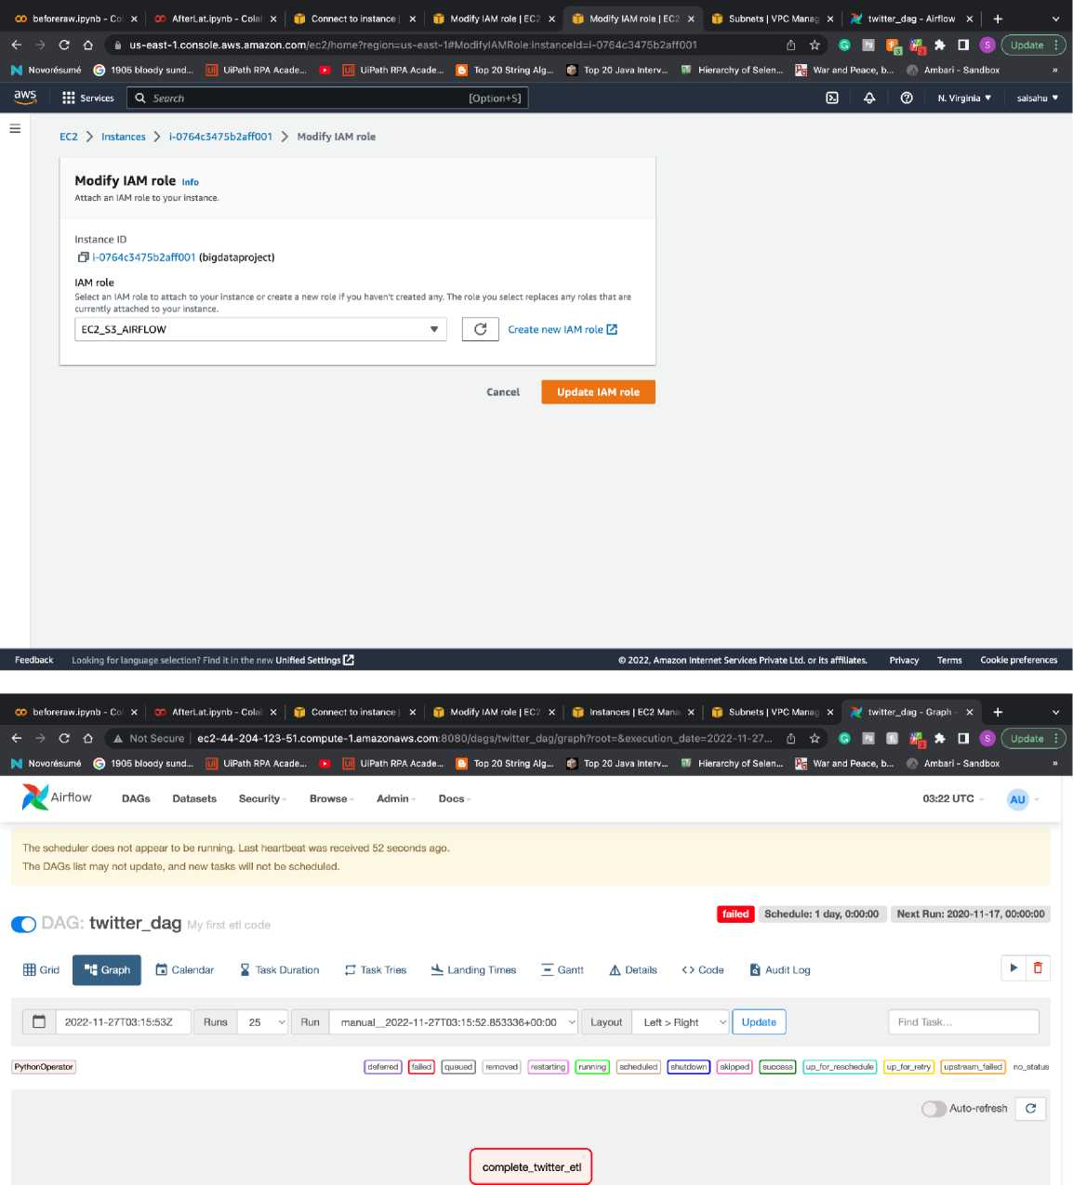

Slide 26
CO beforeraw.ipynb - Co x AfterLat.ipynb - Cola x jfl Connect to instance x |j| Modify 1AM role | ECS X |f Instances | EC2 Man, x List Dag Run - Airflow x v- Track Consignment x +
<- C 6 A Not Secure ec2-44-204-123-51.compute-1.amazonaws.com:8080/dagrun/list/?_flt_3_dag_id=twitter_dag&_flt_3_state=success ft ft m m m * * □ S ( Update
^ Novor6sum6 @ 1905 bloody sund... [u ] UiPath RPA Acade... ► [i UiPath RPA Acade... ft Top 20 String Alg... C Top 20 Java Interv... W Hierarchy of Selen... [j§ War and Peace, b... 4 Ambari - Sandbox
Airflow DAGs Datasets Security Browse Admin Docs
C | AU
Conf | Durat
0 | 38s
0 | 38s
0 | 13s
0 | 13s
0 | 13s
{) | 13s
0 | 13s
0 | 13s
0 | 13s
0 | 13s
0 | 13s
0 | 12s
or a | State | Dag Id twitter_dag | Logical Date 2022-11-27, 03:22:26
a a | *am | twitter_dag | 2022-11-27, 03:22:10
o' a | csa | twitter_dag | 2020-12-03, 00:00:00
or a | EE3 | twitter_dag | 2020-12-02, 00:00:00
3 a |  | twitter_dag | 2020-12-01, 00:00:00
or a |  | twitter_dag | 2020-11-30, 00:00:00
or a |  | twitter_dag | 2020-11-29, 00:00:00
a a |  | twitter_dag | 2020-11-28, 00:00:00
s a |  | twitter_dag | 2020-11-27, 00:00:00
³ • |  | twitter_dag | 2020-11-26, 00:00:00
or a | Bsa | twitter_dag | 2020-11-25, 00:00:00
or it |  | twitter_dag | 2020-11-24, 00:00:00
manual_2022-11 -
27T03:22:26.962543+00:00
Run Type | Queued At | Start Date
manual | 2022-11-27, 03:22:26 | 2022-11-27, 03:22:29
manual | 2022-11-27, 03:22:10 | 2022-11-27, 03:22:29
scheduled | 2022-11-27, 03:25:41 | 2022-11-27, 03:25:41
scheduled | 2022-11-27, 03:25:26 | 2022-11-27, 03:25:26
scheduled | 2022-11-27,03:25:12 | 2022-11-27, 03:25:12
scheduled | 2022-11-27, 03:24:58 | 2022-11-27, 03:24:58
scheduled | 2022-11-27, 03:24:44 | 2022-11-27, 03:24:44
scheduled | 2022-11-27, 03:24:30 | 2022-11-27, 03:24:30
scheduled | 2022-11-27, 03:24:17 | 2022-11-27, 03:24:17
scheduled | 2022-11-27, 03:24:03 | 2022-11-27, 03:24:03
scheduled | 2022-11-27,03:23:49 | 2022-11-27, 03:23:49
scheduled | 2022-11-27, 03:23:35 | 2022-11-27, 03:23:35
End Date Extern
2022-11 -27, 03:23:08 True
2022-11-27,03:23:08 True 2022-11-27,03:25:54 False 2022-11-27,03:25:40 False 2022-11-27,03:25:26 False 2022-11-27,03:25:11 False 2022-11-27,03:24:58 False 2022-11 -27, 03:24:43 False 2022-11-27,03:24:30 False 2022-11-27,03:24:16 False 2022-11-27,03:24:03 False 2022-11-27,03:23:48 False
manual_2022-11-
27T03:22:10.893332+00:00
scheduled_2020-12-
03T00:00:00+00:00
scheduled_2020-12-
02T00:00:00+00:00
scheduled_2020-12-01 T00:00:00+00:00
scheduled_2020-11 -30T00:00:00+00:00
scheduled_2020-11 -
29T00:00:00+00:00
scheduled_2020-11-
28T00:00:00+00:00
scheduled_2020-11 -
27T00:00:00+00:00
scheduled_2020-11-
26T00:00:00+00:00
scheduled_2020-11-
25T00:00:00+00:00
ec2-44-204-123-51.compute-1.amazonaws.com:8080/dags/twitter_dag/graph?r...
scheduled_2020-11 -TOO:00:00+00:00
CO beforeraw.ipynb - Co X y AfterLat.ipynb - Cola X Connect to instance X Q Modify IAM role | EC2 X |jf Instances | EC2 Man; X List Dag Run - Airflow X v> Track Consignment X +
<r -> C G A Not Secure | ec2-44-204-123-51.compute-1.amazonaws.com:8080/dagrun/list/?_flt_3_dagJd=twitter_dag&_flt_3_state=success (h ft $ B I (_ Update
^ Novor£sum6 © 1905 bloody sund... [uj] UiPath RPA Acade... ► [uj UiPath RPA Acade... B Top 20 String Alg... ( Top 20 Java Interv... B1 Hierarchy of Selen... War and Peace, b... 4ft Ambari-Sandbox
^0^ Airflow
□ |B|«l
□ an
□ [B~Il
□ Of *
□ Of «
□ or «
□ a i
□ or a
□ for ja |
□ or a
DAGs Datasets Security Browse Admin Docs
03:26 UTC
AU
13s
twitter_dag | 2020-11-27, 00:00:00 | scneauiea„2U2u-11 -27TOO:OO:0O+OO:OO | scheduled | 2022-11-27,03:24:17 | 2022-11-27, 03:24:17 | 2022-11-27,03:24:30 | False | 0
twitter_dag | 2020-11-26, 00:00:00 | scheduled_2020-11 - 26T00:00:00+00:00 | scheduled | 2022-11-27, 03:24:03 | 2022-11-27, 03:24:03 | 2022-11-27,03:24:16 | False | i)
twitter_dag | 2020-11-25, 00:00:00 | scheduled_2020-11 - 25T00:QQ:Q0+00:0Q | scheduled | 2022-11-27,03:23:49 | 2022-11 -27, 03:23:49 | 2022-11-27,03:24:03 | False | o
twitter_dag | 2020-11-24, 00:00:00 | scheduled_2020-11- 24T00;00;00+00;00 | scheduled | 2022-11-27, 03:23:35 | 2022-11-27, 03:23:35 | 2022-11-27, 03:23:48 | False | 0
twitter_dag | 2020-11-23, 00:00:00 | scheduled_2020-11 - 23T00:QQ:Q0+00:0Q | scheduled | 2022-11-27,03:23:22 | 2022-11-27, 03:23:22 | 2022-11-27,03:23:35 | False | 0
twitter_dag | 2020-11-22, 00:00:00 | scheduled_2020-11- 22T00:Q0:0D+00:00 | scheduled | 2022-11-27, 03:21:11 | 2022-11-27, 03:21:11 | 2022-11-27,03:23:20 | False | {}
twitter_dag | 2020-11-21, 00:00:00 | scheduled_2020-11 - 21T00:00:00+00:00 | scheduled | 2022-11 -27, 03:20:44 | 2022-11 -27, 03:20:44 | 2022-11-27,03:23:08 | False | 0
twitter_dag | 2020-11-20, 00:00:00 | scheduled_2020-11 -2OTOO:OO:0O+OO:OO | scheduled | 2022-11-27,03:20:31 | 2022-11-27, 03:20:31 | 2022-11-27,03:22:29 | False | 0
twitter_dag | 2020-11-19, 00:00:00 | scheduled_2Q2Q-11 -19T00:00:00+00:00 | scheduled | 2022-11-27, 03:20:18 | 2022-11-27, 03:20:18 | 2022-11-27,03:22:29 | False | {)
twitter_dag | 2020-11-18, 00:00:00 | scheduled_2020-11- 18T00:QQ:Q0+Q0:0Q | scheduled | 2022-11-27,03:20:05 | 2022-11 -27, 03:20:05 | 2022-11-27,03:22:29 | False | {}
Version: V2.4.3
I53f0a
ec2-44-204-123-51. compute-1. amazonaws.com;8080/dags/twitter_dag/graph?run_id=scheduled_2020-11-28T00%3A00%3A00%2B00%3A00&executi

Slide 27
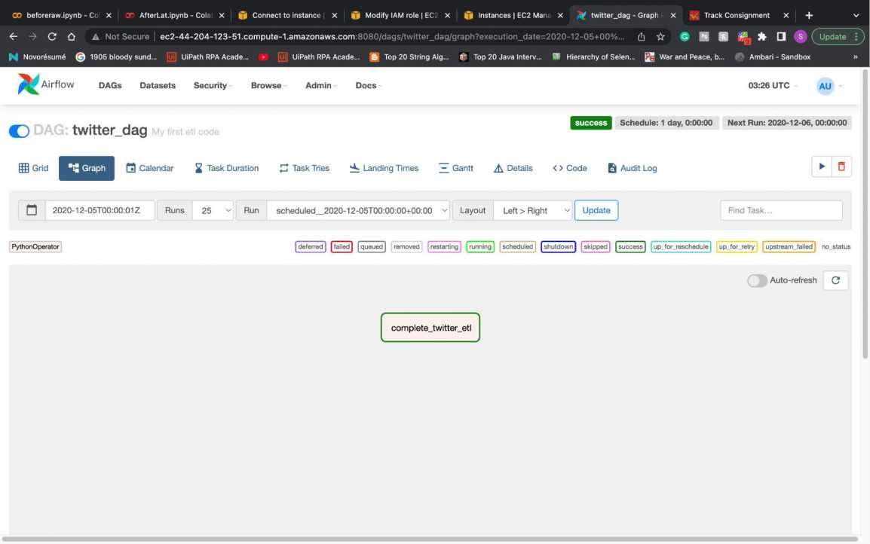
Execution is success after policy modification:
A new CSV file is generated in S3 named bigdtaa.csv:

Slide 28
GO beforeraw.ipynb - Co x AfterLat.ipynb - Cola x jfl Connect to instance x |jl Modify 1AM role | EC2 X ^ S3 Management Cor x twitter_dag - Graph x v Track Consignment x +
<- -> C Ct i s3.console.aws.amazon.com/s3/buckets?region=us-east-1
^ Novor6sum6 © 1905 bloody sund... [u UiPath RPA Acade... ► (i UiPath RPA Aca
[!)☆ • ■ □ S ; Update C)
Top 20 String Alg... f* Top 20 Java Interv... Si Hierarchy of Selen... War and Peace, b... Ambari - Sandbox
•j; Services Q. Search
0 ^ (2) Global ▼ saisahu ▼
Amazon S3
Buckets Access Points
Object Lambda Access Points Multi-Region Access Points Batch Operations Access analyzer for S3
© We're continuing to improve the S3 console to make it faster and easier to use. If you have feedback on the updated experience, choose Provide feedback.
© Easily transfer data between AWS Storage services with AWS DataSync.
Provide feedback
Amazon S3 > Buckets
► Account snapshot
Storage lens provides visibility into storage usage and activity trends. Learn more £3
View Storage Lens dashboard
Block Public Access settings for this account
▼ Storage Lens
Dashboards
AWS Organizations settings Feature spotlight Q ► AWS Marketplace for S3
Buckets (1) mfo
Buckets are containers for data stored in S3. Learn more £3
C (3 CopyARN
Q. Find buckets by name
< 1 > ®
Creation date v
November 26, 2022, 21:51:48 (UTC-05:00)
Name A
O bigdataprojectlambton
AWS Region ^
US East (N. Virginia) us-east-1
Access ^
Bucket and objects not public
Feedback Looking for language selection? Find it in the new Unified Settings QfJ
© 2022, Amazon Internet Services Private Ltd. or its affiliates. Privacy Terms Cookie preferences
CO beforeraw.ipynb - Co X Z<~ AfterLat.ipynb - Cola X j) Connect to instance X Q Modify IAM role | EC2 X bigdataprojectlambl X ^ twitter_dag - Graph X fy£ Track Consignment X +
<- -> C A- i s3.console.aws.amazon.com/s3/buckets/bigdataprojectlambton?region=us-east-18itab=objects
6 • ■ It, * □ S ( Update ! ,
^ Novor6sum6 © 1905 bloody sund... [uj] UiPath RPA Acade... ► [uj UiPath RPA Acade... B Top 20 String Alg... ( Top 20 Java Interv... SI Hierarchy of Selen... War and Peace, b... 4ft Ambari-Sandbox
^ I;; Services Q. Search
0 & © Global v saisahu »
Amazon S3
Buckets Access Points
Object Lambda Access Points Multi-Region Access Points Batch Operations Access analyzer for S3
Block Public Access settings for this account
▼ Storage Lens
Dashboards
AWS Organizations settings Feature spotlight ► AWS Marketplace for S3
© We're continuing to improve the S3 console to make it faster and easier to use. If you have feedback on the updated experience, choose Provide feedback.
© Easily transfer data between AWS Storage services with AWS DataSync.
Provide feedback
Amazon S3 > Buckets > bigdataprojectlambton
bigdataprojectlambton mi.
Objects Properties Permissions Metrics Management Access Points
Objects are the fundamental entities stored in Amazon S3. You can use Amazon S3 inventory Qfl to get a List of all objects in your bucket. For others to access your objects, you'll need to explicitly grant them permissions. Learn more D3
© | fi) Copy S3 URI 3 Copy URL £k] Download Open £3 Delete [ Actions ▼ | | Created
SI upload
Q. Find objects by prefix
< 1 > ©
Name
Q Bigdata.csv
Last modified
November 26, 2022,22:27:45 (UTC-05:00)
Storage das
Feedback Looking for language selection? Find it in the new Unified Settings
D 2022, Amazon Internet Services Private Ltd. or its affiliates. Privacy Terms Cookie preferences

Slide 29
GO beforeraw.ipynb - Cc x AfterLat.ipynb - Cola x jfl Connect to instance x |jl Modify 1AM role | ECJ X ^ bigdataprojectlambt x Af twitter_dag - Graph x v Track Consignment x +
C O i s3.console.aws.amazon.com/s3/buckets/bigdataprojectlambton?region=us-east-1&tab=objects
(!) ☆ # ■ ^ Update
^ Novor6sum6 © 1905 bloody sund... [u UiPath RPA Acade...
UiPath RPA Acade... £K Top 20 String Alg... 0 Top 20 Java Interv...
Hierarchy of Selen... |jgj War and Peace, b...
0 ^ © Global ▼ saisahu ▼
•j; Services Q. Search
Amazon S3
Buckets Access Points
Object Lambda Access Points Multi-Region Access Points Batch Operations Access analyzer for S3
Block Public Access settings for this account
▼ Storage Lens
Dashboards
AWS Organizations settings Feature spotlight Q ► AWS Marketplace for S3
© We're continuing to improve the S3 console to make it faster and easier to use. If you have feedback on the updated experience, choose Provide feedback.
© Easily transfer data between AWS Storage services with AWS DataSync.
Provide feedback
Amazon S3 > Buckets > bigdataprojectlambton
bigdataprojectlambton
Objects Properties Permissions Metrics Management Access Points
Objects are the fundamental entities stored in Amazon S3. You can use Amazon S3 inventory Q3 to get a list of all objects in your bucket. For others to access your objects, you'll need to explicitly grant them permissions. Learn more E
O 0 Copy S3 URI 0 Copy URL ty Download Open [£ Delete Actions
Etl Upload
< 1 > ©
Q. Find objects by prefix
Name
Q Bigdata.csv
Last modified
November 26, 2022, 22:27:45 (UTC-05:00)
Feedback Looking for language selection? Find it in the new Unified Settings 03
© 2022, Amazon Internet Services Private Ltd. or its affiliates. Privacy Terms Cookie preferences
File properties with location and date created:
00 beforeraw.ipynb - Co x AfterLat.ipynb - Cola x |fl Connect to instance x |g Modify 1AM role | EC: X ^ bigdataprojectlambt x ^ twitter_dag - Graph X v Track Consignment x +
C O i s3.console.aws.amazon.com/s3/object/bigdataprojectlambton?region=us-east-1&prefix=Bigdata.csv
06- • ■ l|j * □ S (^Update
h Novor^sume © 1905 bloody sund... [u UiPath RPA Acade... ► [i UiPath RPA Acade... ^ Top 20 String Alg... £ Top 20 Java Interv... (9 Hierarchy of Selen... War and Peace, b... i Ambari - Sandbox
Services Q. Search
0 <& © Global ▼ saisahu ▼
Amazon S3
© We're continuing to improve the S3 console to make it faster and easier to use. If you have feedback on the updated experience, choose Provide feedback.
Provide feedback
Buckets Access Points
Object Lambda Access Points Multi-Region Access Points
Bigdata.csv
l3 Copy S3 URI | EB Download Open E Object actions
Properties Permissions Versions
Batch Operations Access analyzer for S3
Block Public Access settings for this account
▼ Storage Lens
Dashboards
AWS Organizations settings Feature spotlight ► AWS Marketplace for S3
Object overview
Owner
ssahu8.sahu
AWS Region
US East (N. Virginia) us-east-1 Last modified
November 26, 2022, 22:27:59 (UTC-05:00)
Size 93.9 KB
Type
CSV
Key
fi) Bigdata.csv
S3 URI
(3 s3://bigdataprojectlambton/Bigdata.csv
Amazon Resource Name (ARN)
(3 arn:aws:s3:::bigdataprojectlambton/Bigdata.csv
Entity tag (Etag)
(3 0e04ec39943b6279d787828f971147f4 Object URL
(3 https://bigdataprojectlambton.s3.amazonaws.com/Bigdata.csv
Feedback Looking for language selection? Find it in the new Unified Settings (3
© 2022, Amazon Internet Services Private Ltd. or Its affiliates. Privacy Terms Cookie preferences

Slide 30
GO beforeraw.ipynb - Colabor x AfterLat.ipynb - Colabora' x Connect to instance | EC2 x ^ bigdataprojectlambton - S x twitter_dag - Graph - Airfl x Track Consignment
-> C O i s3.console.aws.amazon.com/s3/object/bigdataprojectlambton?region=us-east-1&prefix=Bigdata.csv&tab=details
(!) ☆ • ■ l|j □ S ( Update
^ Novor6sum6 © 1905 bloody sund... [u UiPath RPA Acade... ^!3i :!i Services Q. Search
UiPath RPA Acade... Top 20 String Alg... 0 Top 20 Java Interv... W Hierarchy of Selen... War and Peace, b... 0S Ambari - Sandbox >
[Option+S] © £■ © Global * saisahu ▼
Amazon S3
© We're continuing to improve the S3 console to make it faster and easier to use. If you have feedback on the updated experience, choose Provide feedback.
Provide feedback
Buckets Access Points
Object Lambda Access Points Multi-Region Access Points Batch Operations Access analyzer for S3
Block Public Access settings for this account
Storage Lens
Dashboards
AWS Organizations settings
Object overview
S3 URI
0 s3://bigdataprojectlambton/Bigdata.csv
Amazon Resource Name (ARN)
(3 arn:aws:s3:::bigdataprojectlambton/Bigdata.csv
Entity tag (Etag)
3 0e04ec39943b6279d787828f971147f4
AWS Region
US East (N. Virginia) us-east-1 Last modified
November 26, 2022, 22:30:31 (UTC-05:00)
Feature spotlight Q
Object URL
3 https://bigdataprojectlambton.s3.amazonaws.com/Bigdata.csv
► AWS Marketplace for S3
Key
3 Bigdata.csv
Object management overview
Feedback Looking for language selection? Find it in the new Unified Settings 03
D 2022, Amazon Internet Services Private Ltd. or its affiliates. Privacy Terms Cookie preferences
Data inside the file:
We successfully executed this in cloud and stored in a S3 where it can be access by anyone anywhere with S3 access .
This also can be used a data source for a website there it can fetch the real time data.

Slide 31
ED View |  | 125% ~ Zoom | Add Categor | QS©E?l6Slj: 3) Pivot Table Insert Table Chart Text Shape Media Comment Collaborate | & ® Format Organize
+ |  | Sheet 1 |  |  | Sheet
 |  |  |  |  | Sheet Name Sheet 1
 |  | date | User | Tweet
 | 0 | 2022-11-27 03:27:30+00:00 | Kate_DowlingNZ | ©Bridgetpee It's near the bottom of a hill; the slope there is fairly moderate. The CBD is nearby, but across a busy street - The Terrace - and dov | Backoround •
 | 1 | 2022-11-27 03:19:05+00:00 | andicbuchanan | ©Bridgetpee ©irihapeta along the terrace and down through the Lambton Square shopping centre but it's still not great. Where do you need to 1
 | 2 | 2022-11-27 02:40:45+00:00 | hunterarts | What a day we have for Art Bazaar at Lambton Park today! -------Mm https;//t.cp/amF1 yB8f4n | Duplicate Sheet
 | 3 | 2022-11-27 02:40:26+00:00 | hunterarts | What a day we have for Art Bazaar at Lambton Park today! | Delete Sheet
 |  |  |  | https://t.co/SETetiFKC4
 | 4 | 2022-11-27 02:40:02+00:00 | hunterarts | What a day we have for Art Bazaar at Lambton Park today! « , https ://t.co/jAb773QIZu
 | 5 | 2022-11-27 02:39:36+00:00 | hunterarts | What a day we have for Art Bazaar at Lambton Park today! https ://t.co/et5AvlAwHI
 | 6 | 2022-11-27 02:20:21+00:00 | LambtonJSAAA | Nov 26 Game Score: U18 2005-2006 -1. Waterloo Wolves - 6 httos^/t.co/31 SttOEpSl
 | 7 | 2022-11-27 02:10:14+00:00 | SouthKentl | Nov 26 Game Score: U18 C - 3, East Lambton Eagles C - 2 https://t.co/3TstyosPvK
 | B | 2022-11-27 01:32:12+00:00 | W_Lakers_Hockey | Nov 26 Game Score: U15 - U15 C Rep - 0. East Lambton Eaqles C - 4 https://t.co/UaXOjZR25h
 | 9 | 2022-11-27 01:25:16+00:00 | LambtonJSAAA | Nov 26 Game Score: U13 2010 - 6. Chatham-Kent Cyclones - 3 https://t.co/jaJ7ahDNWr
 | 10 | 2022-11-27 00:51:08+00:00 | STPanthers | Nov 26 Game Score: U18 BB - Brown &amD: Jackson #6802 - 3. Lambton Attack -1 https://t.co/sYv7lrOMsm
 | 11 | 2022-11-27 00:31:30+00:00 | petrol iaoilers | Nov 26 Game Score: U15 C fAE) -1. East Lambton Eaqles D - 8 https://t.co/WC8IUVbuOD
 | 12 | 2022-11-27 00:15:16+00:00 | IldertonJets | Nov 26 Game Score: U11 Boys White - 9. East Lambton Eaqles White - 0 https://t.co/ZSxuOwvRV4
 | 13 | 2022-11-27 00:05:12+00:00 | brantfordminor | Nov 26 Game Score: AAA - U15 - 1. Lambton Jr Stinq - 3 https;//t,Co/1 qTvzWI 8qH
 | 14 | 2022-11-27 00:05:11+00:00 | LambtonJSAAA | Nov 26 Game Score: U15 2008 - 3. Brantford 99ers -1 httDS://t.co/XEXcC44N7r
 | 15 | 2022-11-26 23:42:4B+00:00 | SandobaMariano | httos://Leo/TzefPAwKFA - Prostate health promoted in Sarnia-Lamhton - https://t.co/TzefPA-wKFA httos://t.co/w1o0lyKHJL tfprostate
 | 16 | 2022-11-26 23:33:51+00:00 | brantfordminor | Nov 26 Game Score: AAA - U14 - 2. Lambton Jr Stinq - 2 https^/t.co/mBBL3X2ELm
 | 17 | 2022-11-26 23:33:50+00:00 | LambtonJSAAA | Nov 26 Game Score: U14 2009 - 2. Brantford 99ers - 2 https://t.co/7ygxTcbEMQ
 | 18 | 2022-11-26 23:00:05+00:00 | petrol iaoilers | Nov 26 Game Score: U13 B (REPl - 1. Lambton Shores Predators C - 3 httos://t.co/hYk4Uxdvro
 | 19 | 2022-11-26 22:52:07+00:00 | WindsorAAA | Nov 26 Game Score: U12 (2011} - 5. Lambton Jr Stina - 5 https://t.co/8R4h5eRPiJ
 | 20 | 2022-11-26 22:52:05+00:00 | LambtonJSAAA | Nov 26 Game Score: U12 2011 - 5. Windsor Jr Spitfires - 5 https://t.co/WU2albm4Bb
 | 21 | 2022-11-26 22:41:44+00:00 | W_Lake rs_ H ockey | Nov 26 Game Score: U11 - U11 C Rep - 3. Lambton Shores Predators C - 0 httR§;//tiW/Jlj7kgZo90
 | 22 | 2022-11-26 22:40:12+00:00 | LambtonHoops | Conestooa has a hot second half as the Lions droo this afternoon's aame. Journee Joseoh and Jerrv Wilson each scored 20. htfos://t.co/adHvV
 | 23 | 2022-11-26 22:30:10+00:00 | hunterarts | All set uo for Art Bazaar at Lambton Park! We are here until 3om todav B httos:y/t.co/rVvalVOP86

